Slide 1
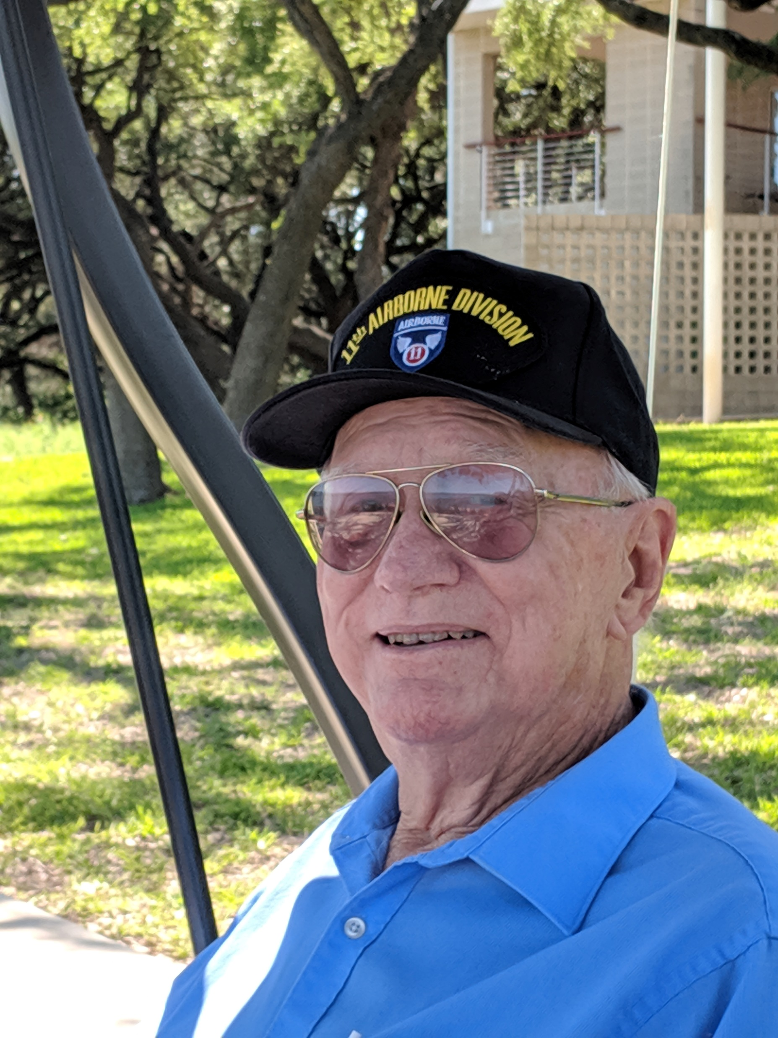
Alan Carmichael, Sr
June 20, 1933
–
December 8, 2022
A life well-lived…

Slide 2
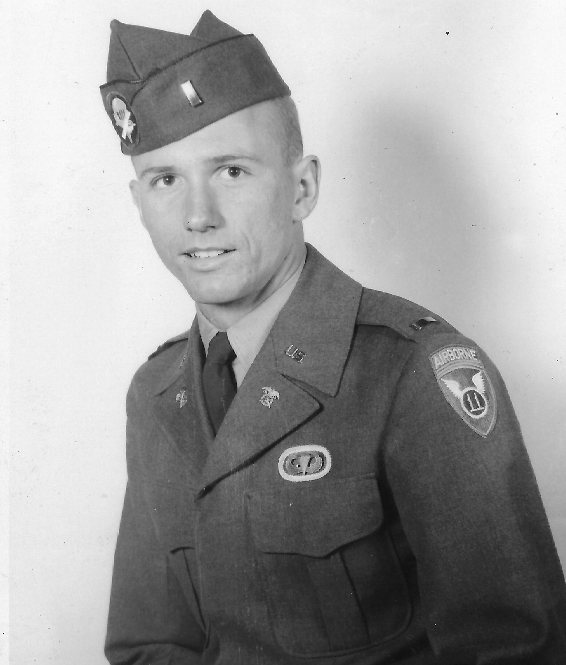
Brand new Paratrooper - 1955

Slide 3
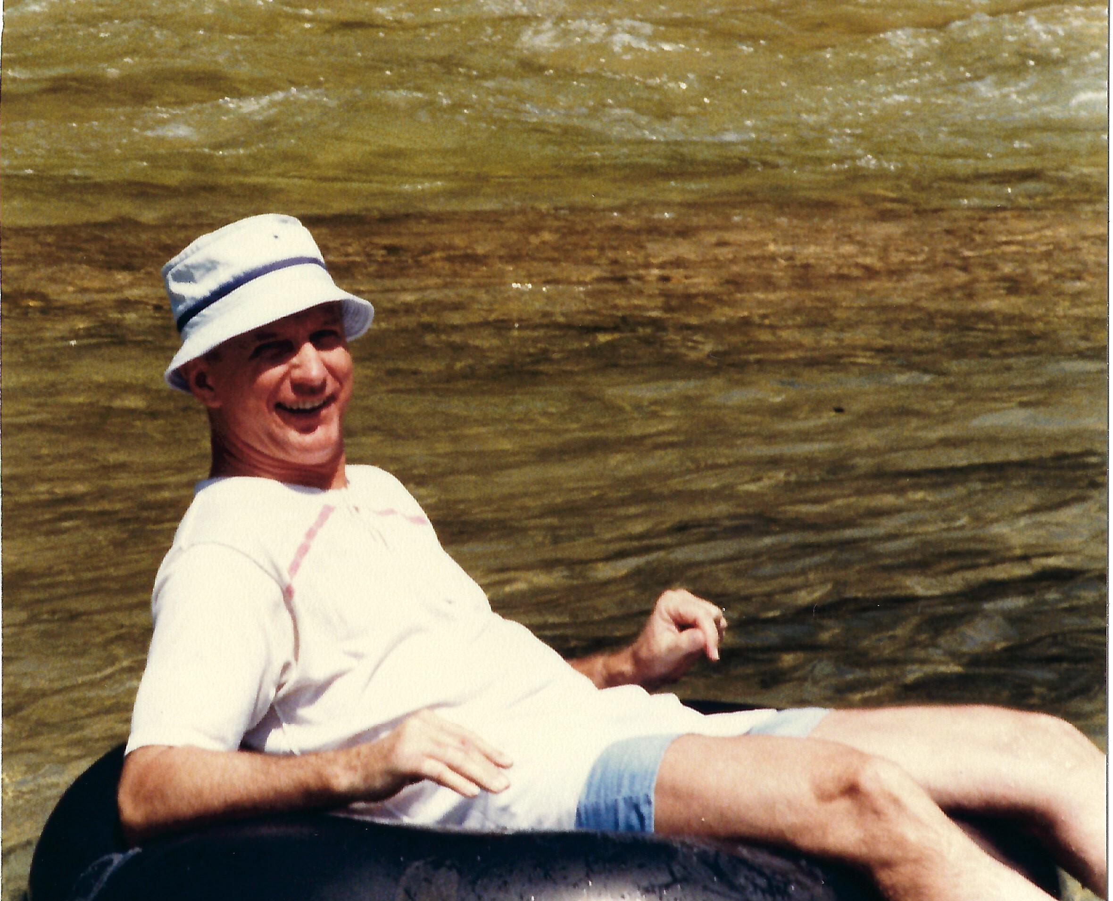
Tubing on the Frio

Slide 4
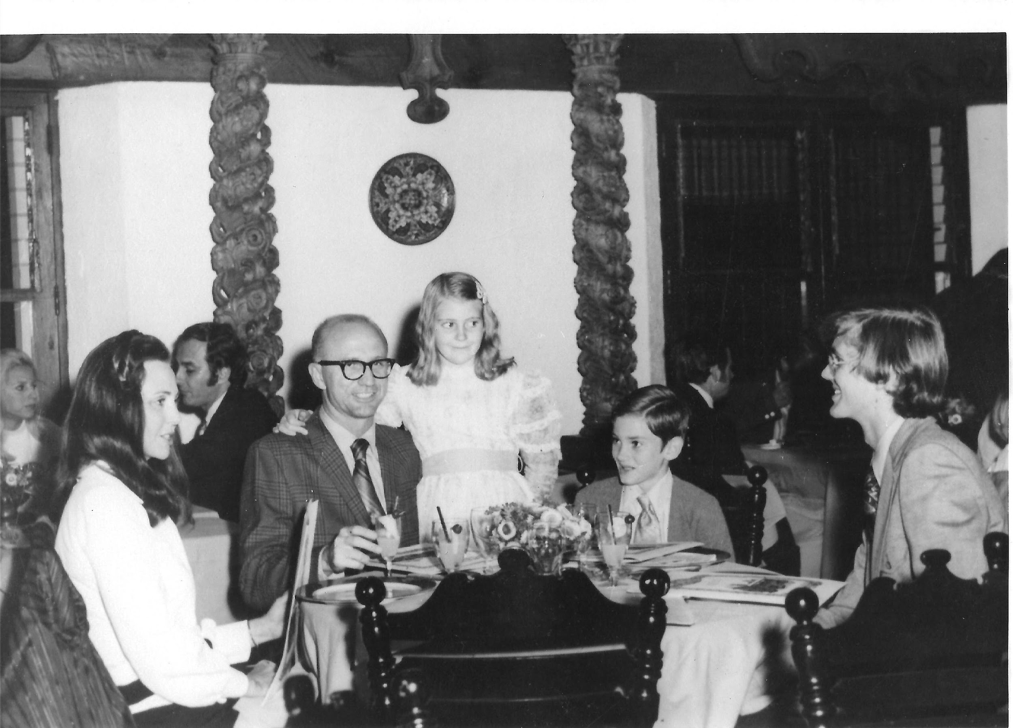
Dinner at the Moderno in Piedra Negras

Slide 5
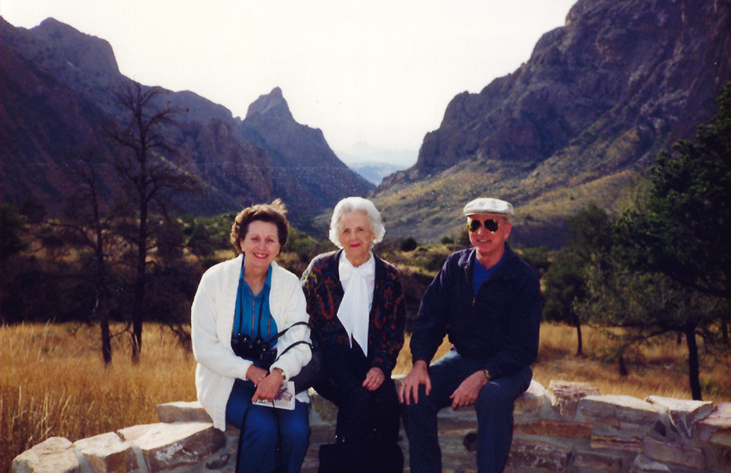
In Big Bend with Bea and Dorothy McWhirter

Slide 6
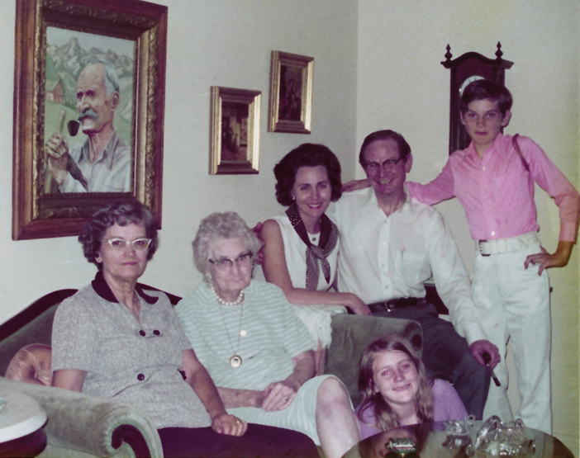
Mary, Grandmother, Bea, Art, Wayne, Anna

Slide 7
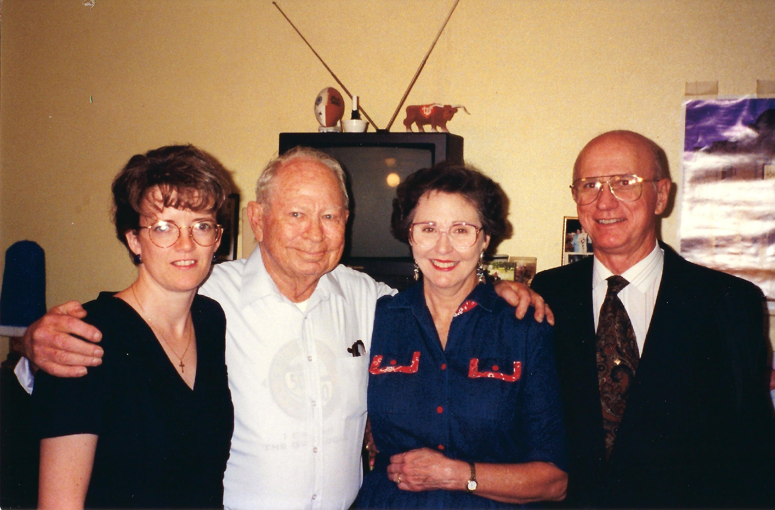
Daughter in-law Gina, Brother in-law Buddy, Bea, Alan

Slide 8
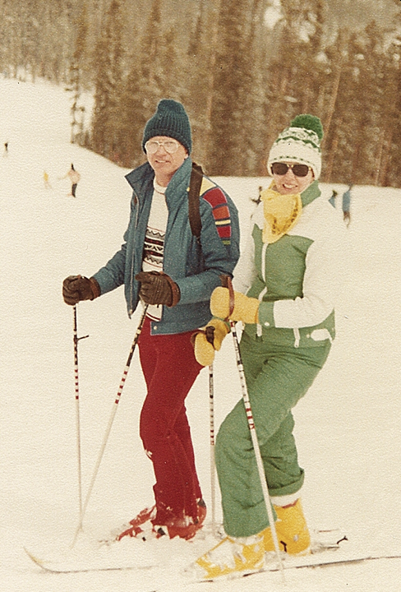
Skiing in Colorado

Slide 9
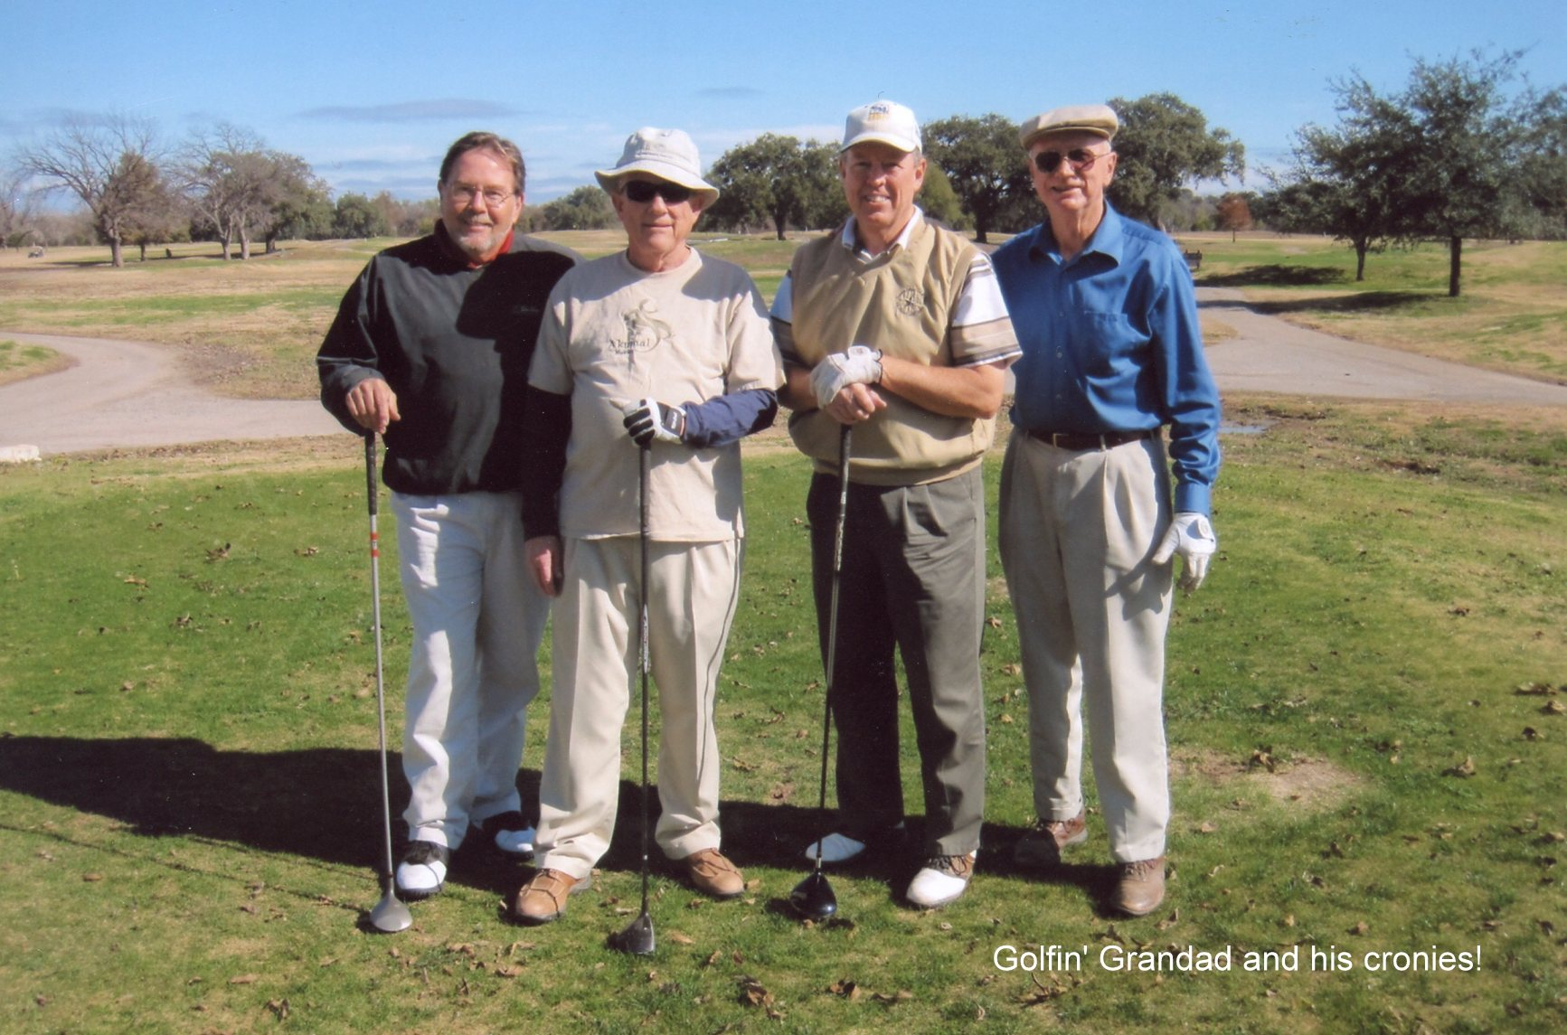
Jim Williams, Tom Harwood, Bob Lester with Alan 2009

Slide 10
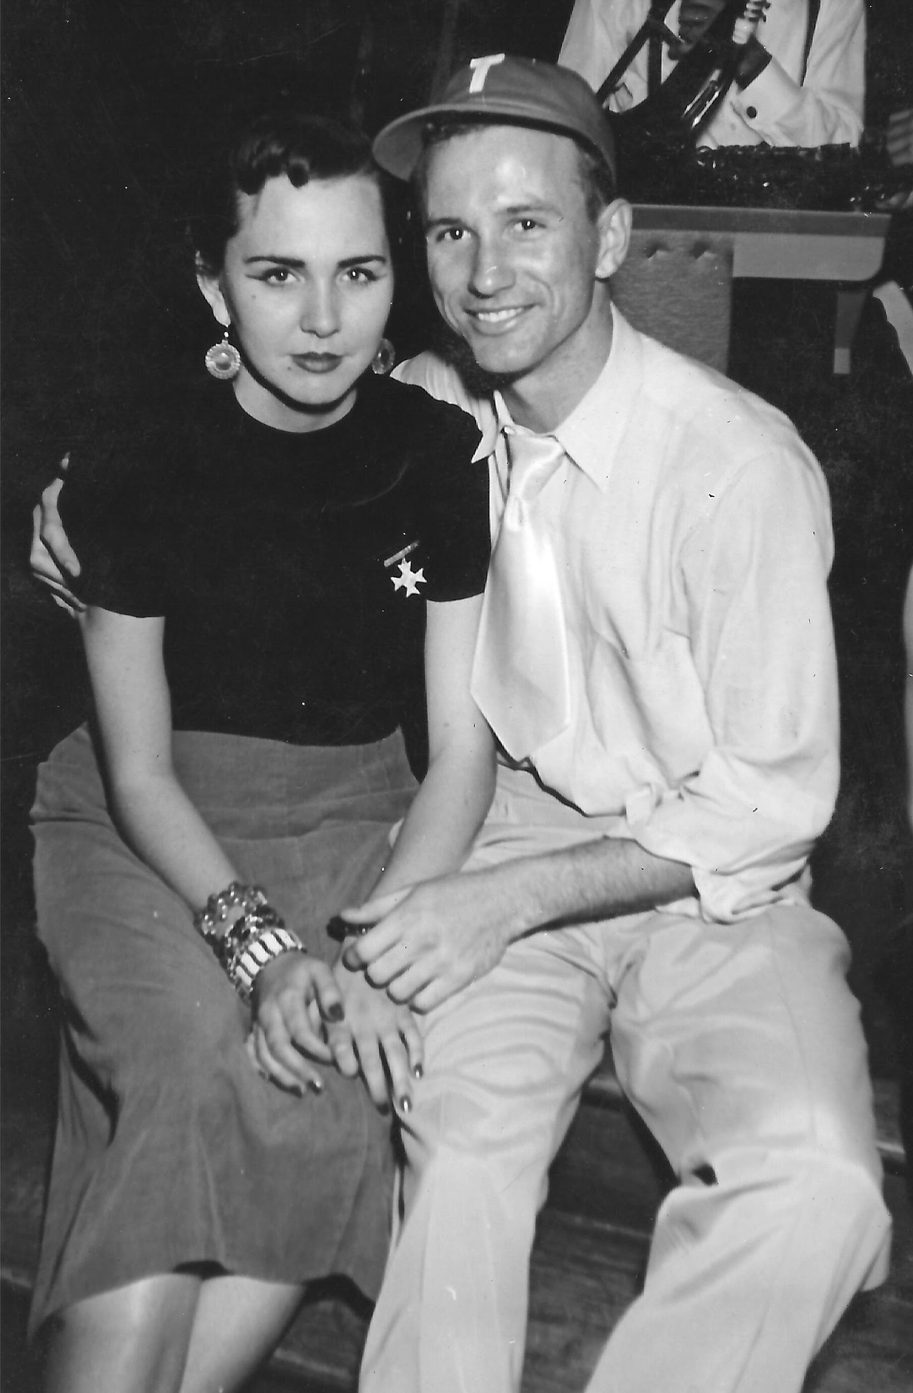
Out on the town at UT with Bea, 1953

Slide 11
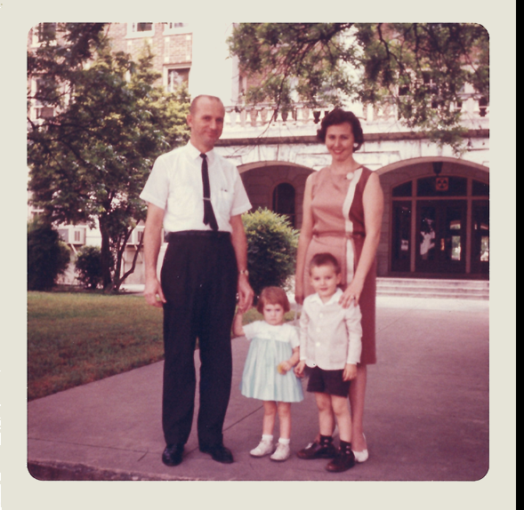
Alan, Anna, Bea and Wayne

Slide 12
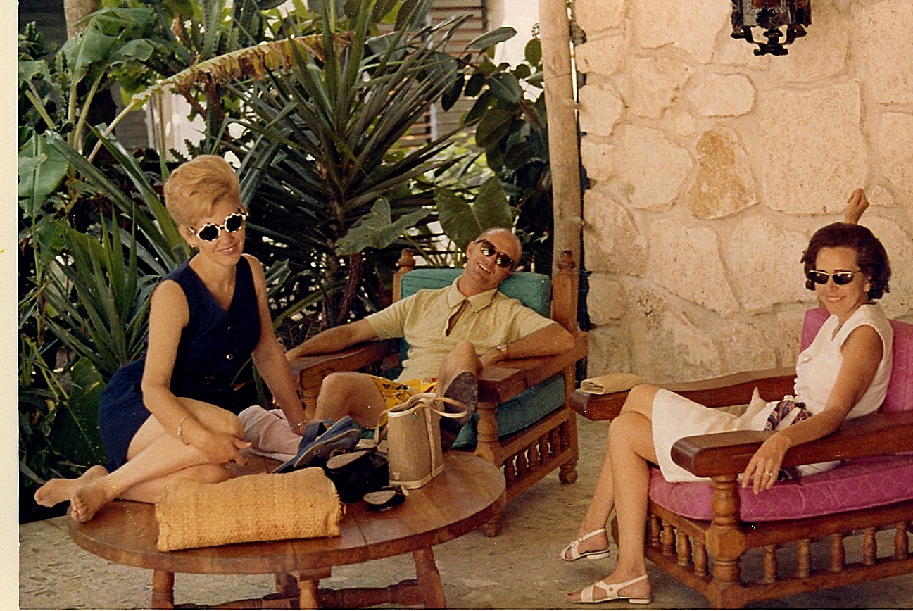
Frances McKinley, Alan and Bea at El Pedrigal, Piedras Negras

Slide 13
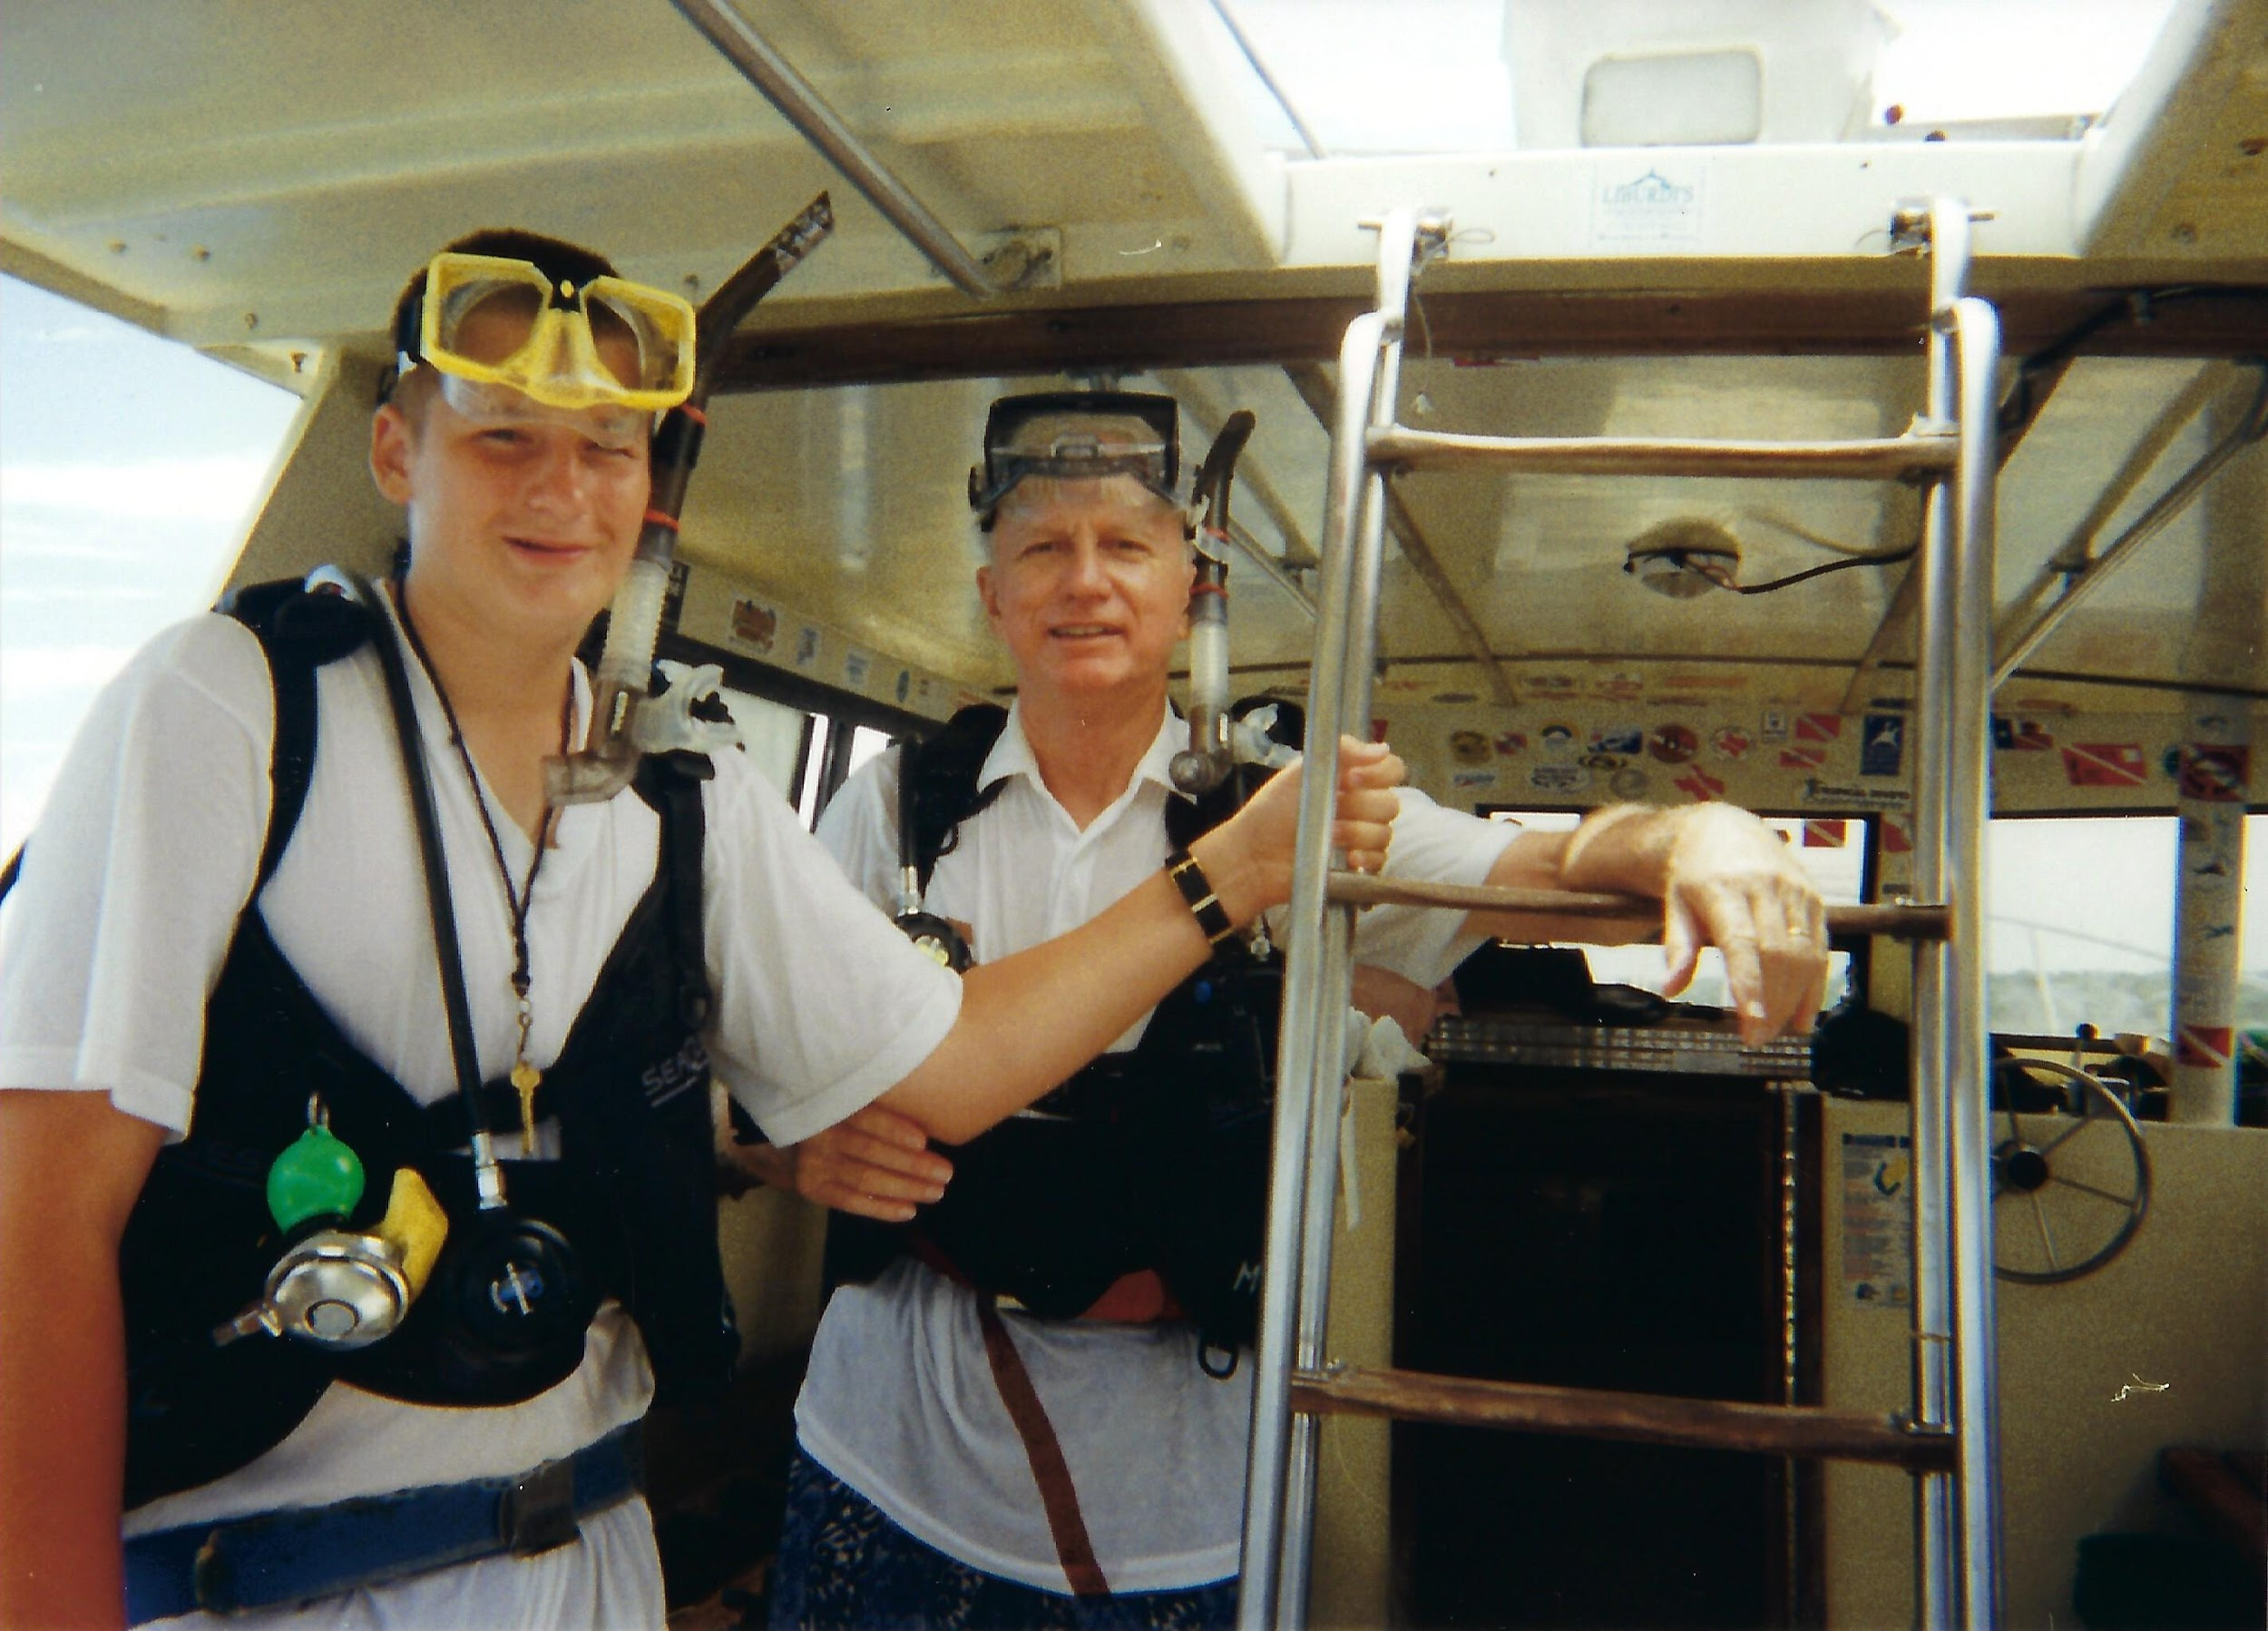
Scuba diving in Cozumel with Logan

Slide 14
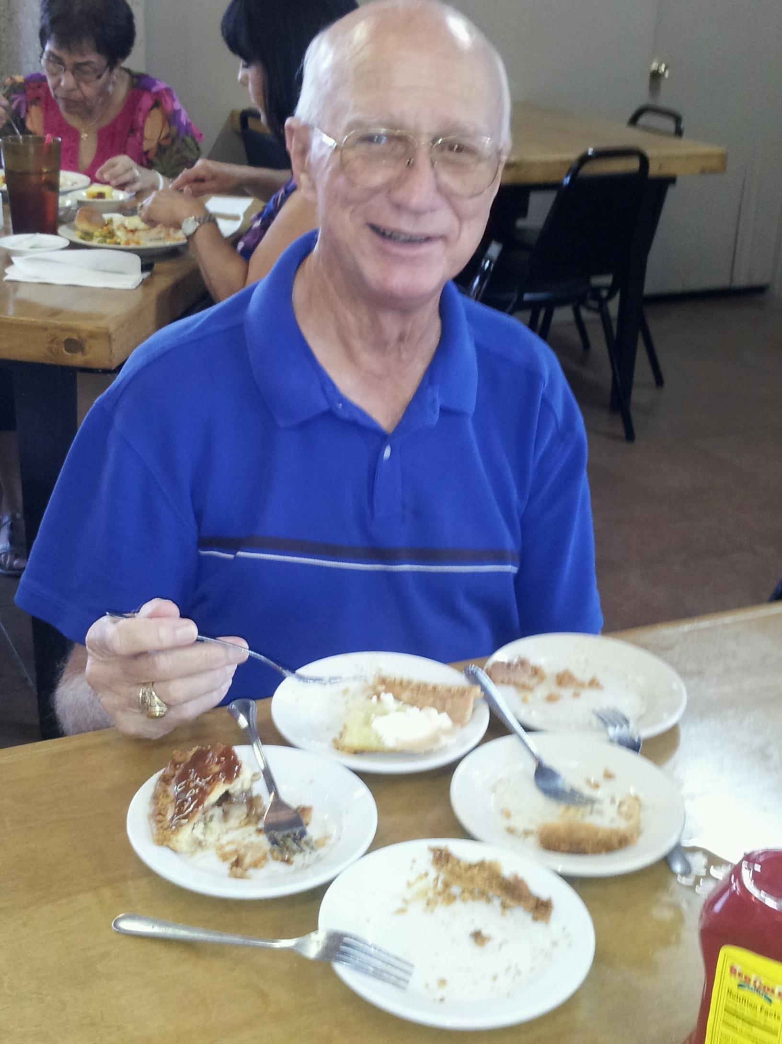
Pie anyone?

Slide 15
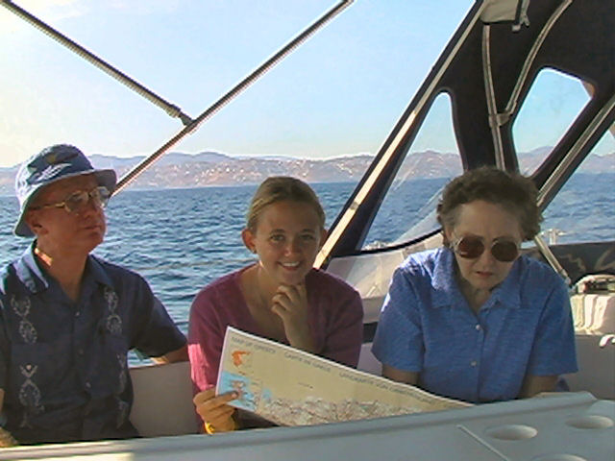
Sailing the Cyclades of the Aegean after the games

Slide 16
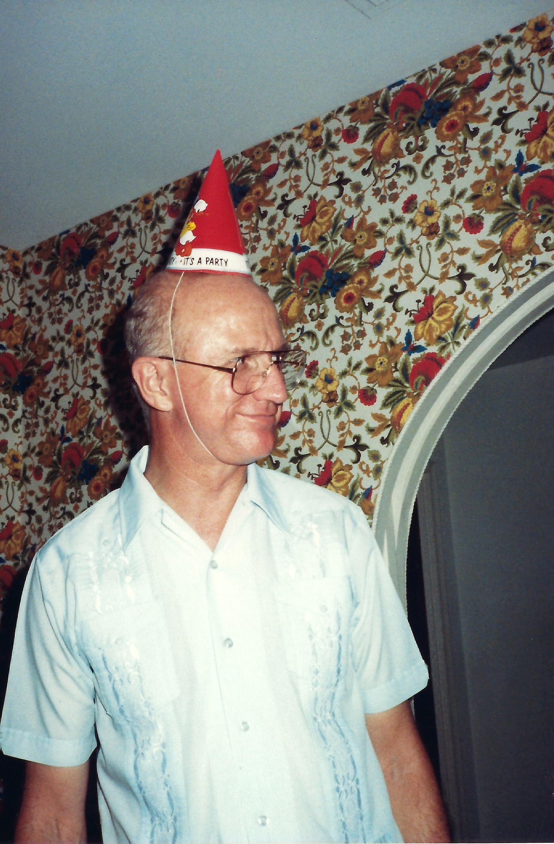
Nice Hat!

Slide 17
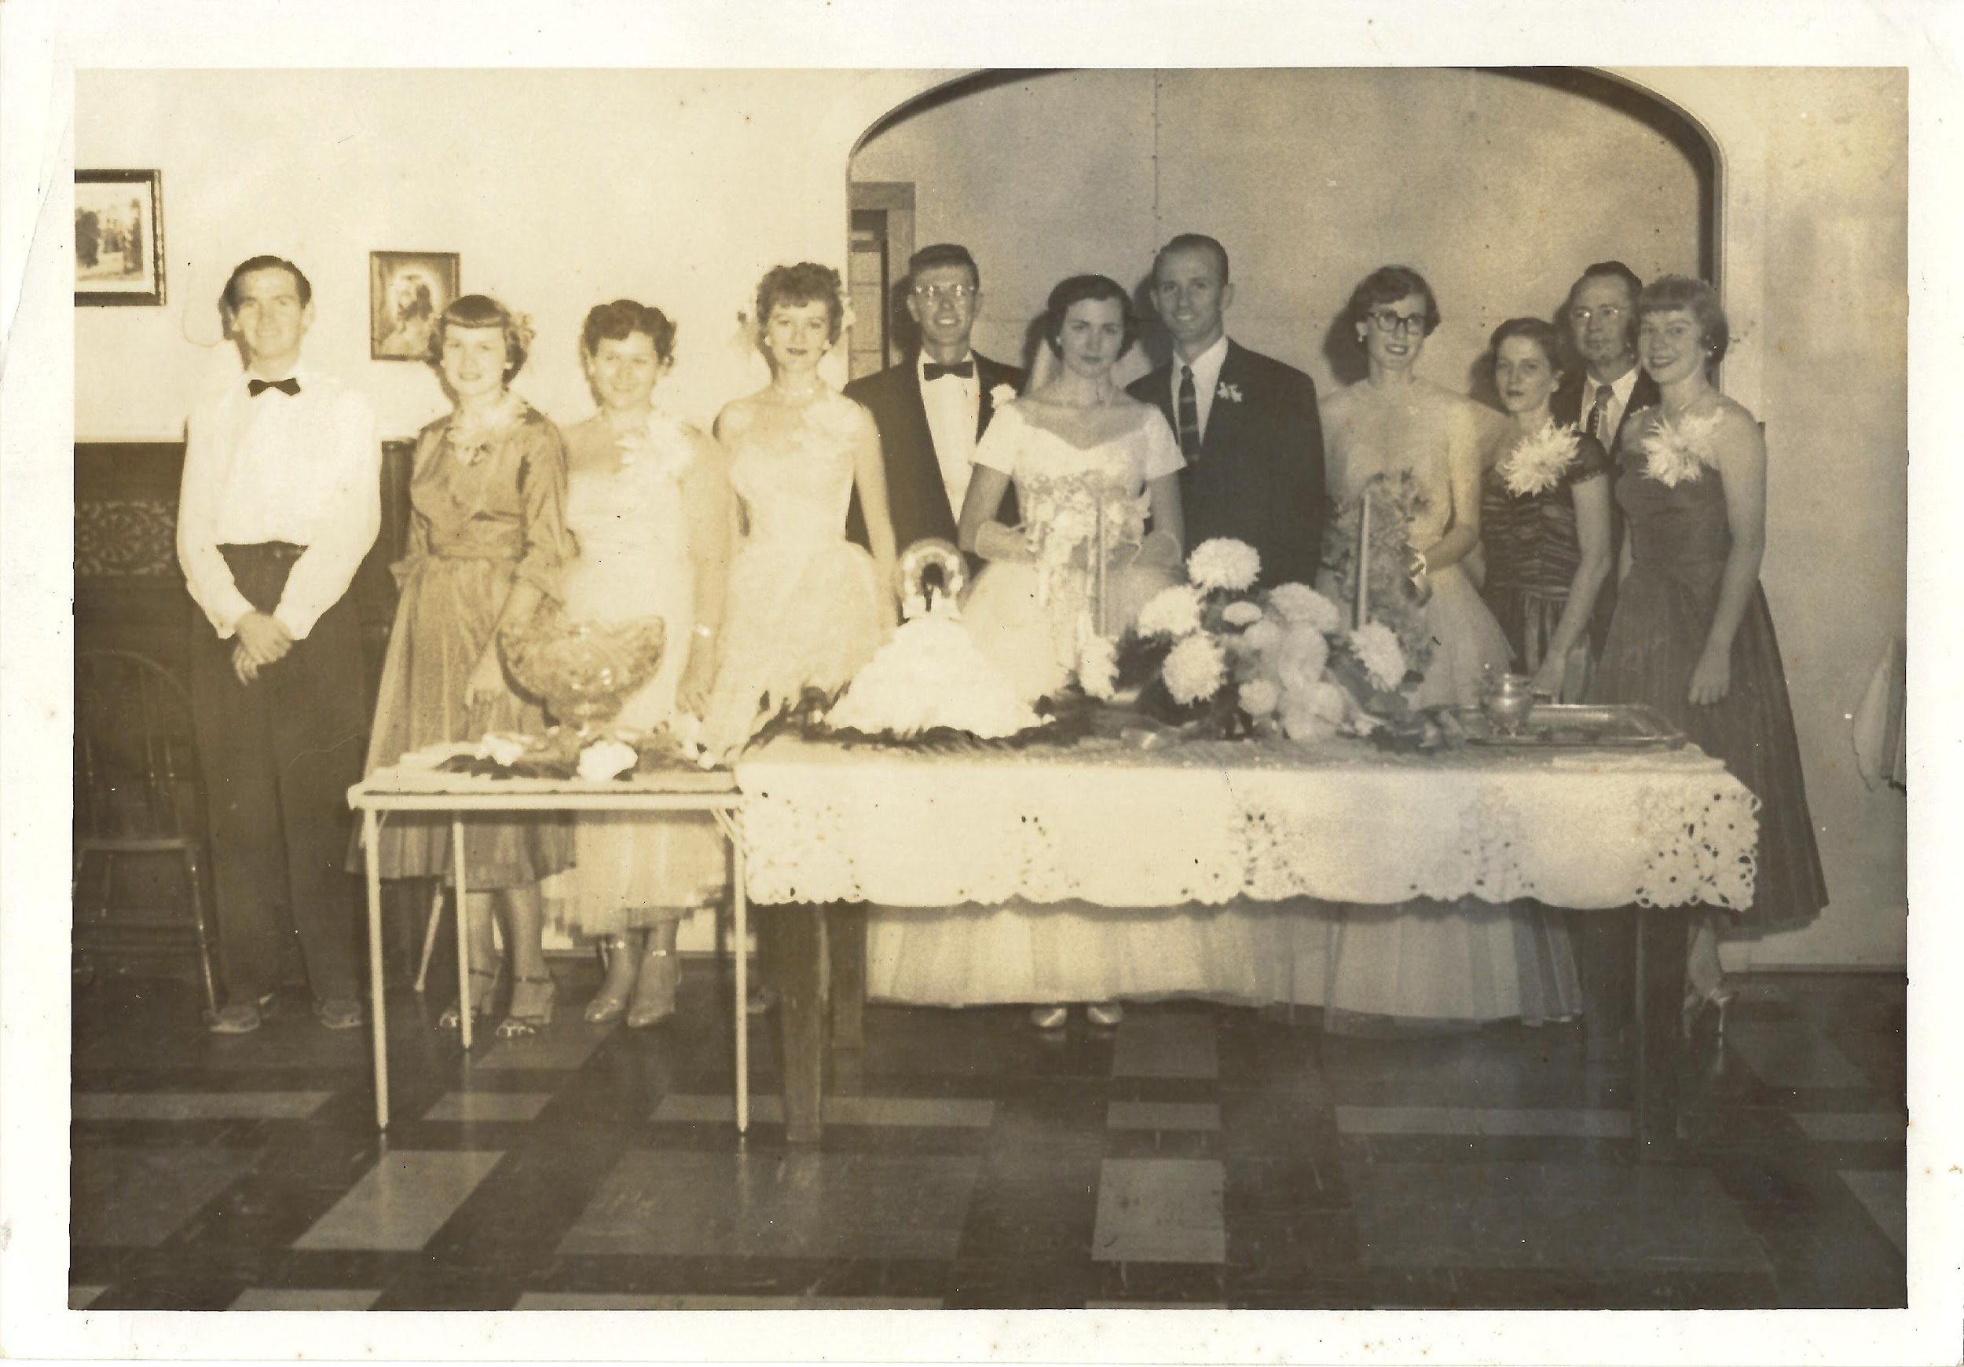
Wedding photo 1954 in Mineral Wells

Slide 18
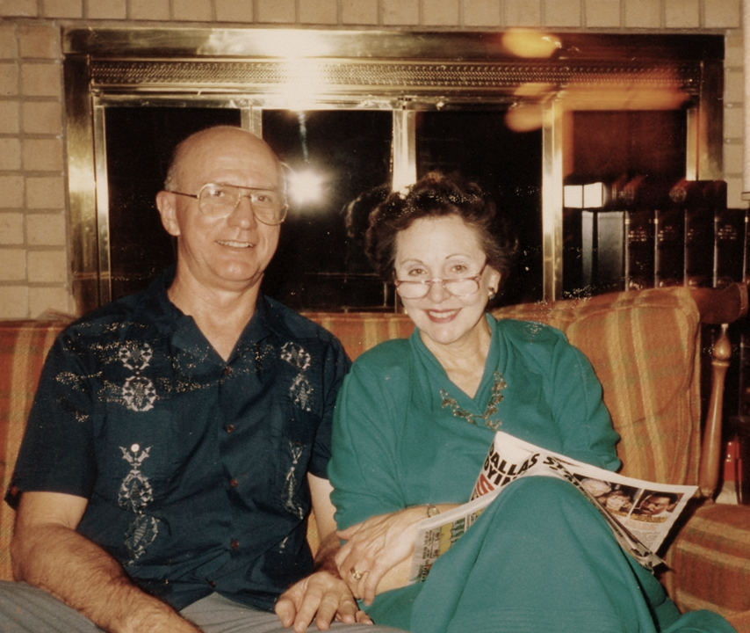
Comfy at home together

Slide 19
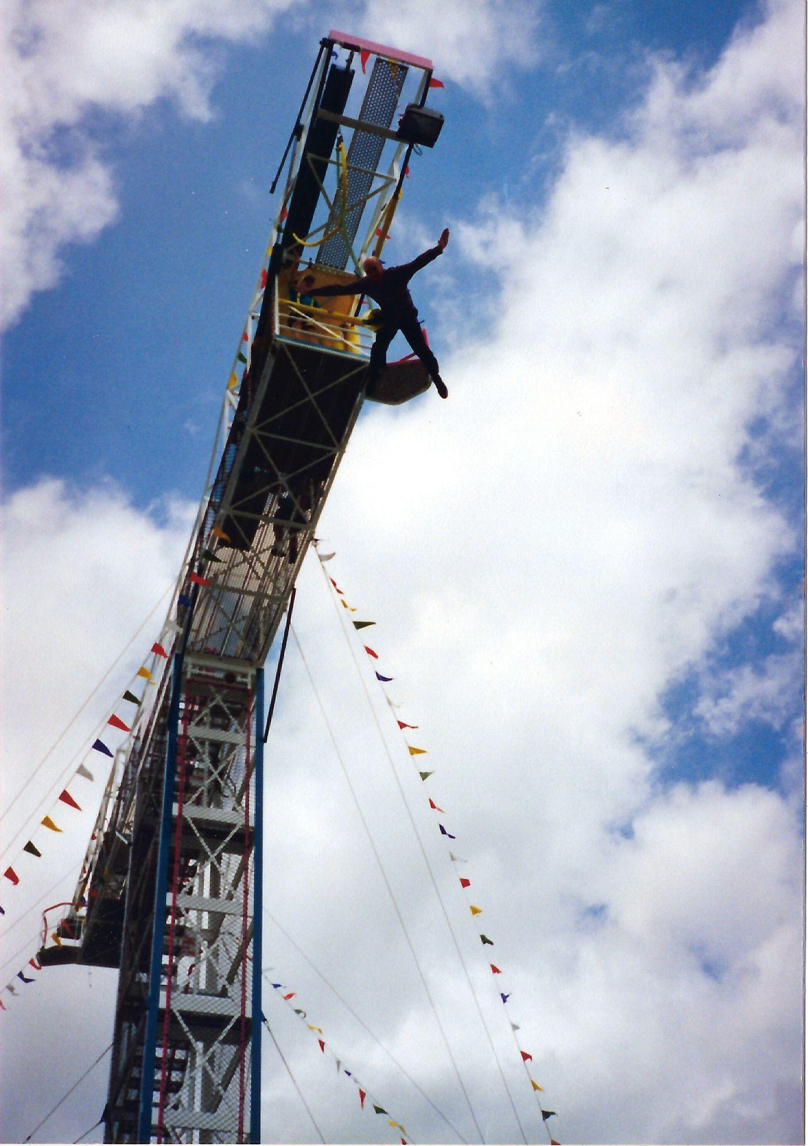
Bungee jumping on 70th birthday
Once an 11th Airborne Paratrooper….
Always an 11th Airborne Paratrooper

Slide 20
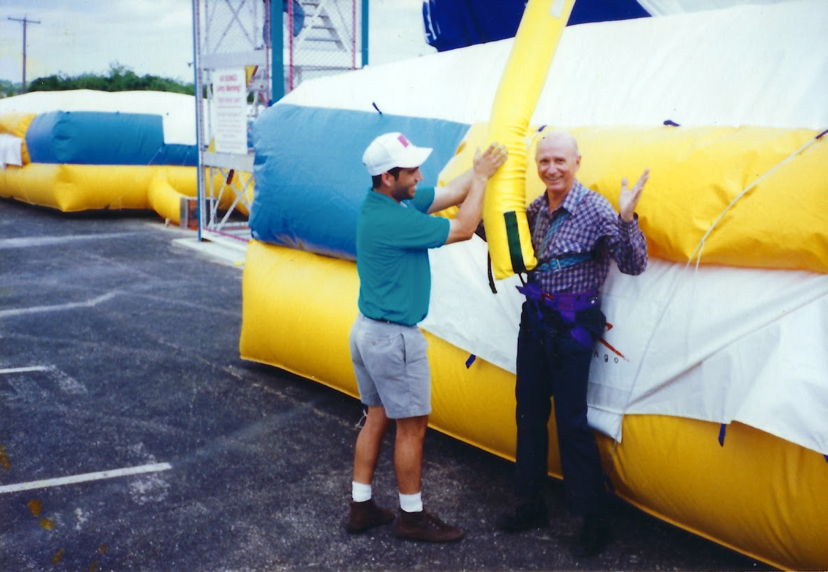
Easy landing!

Slide 21
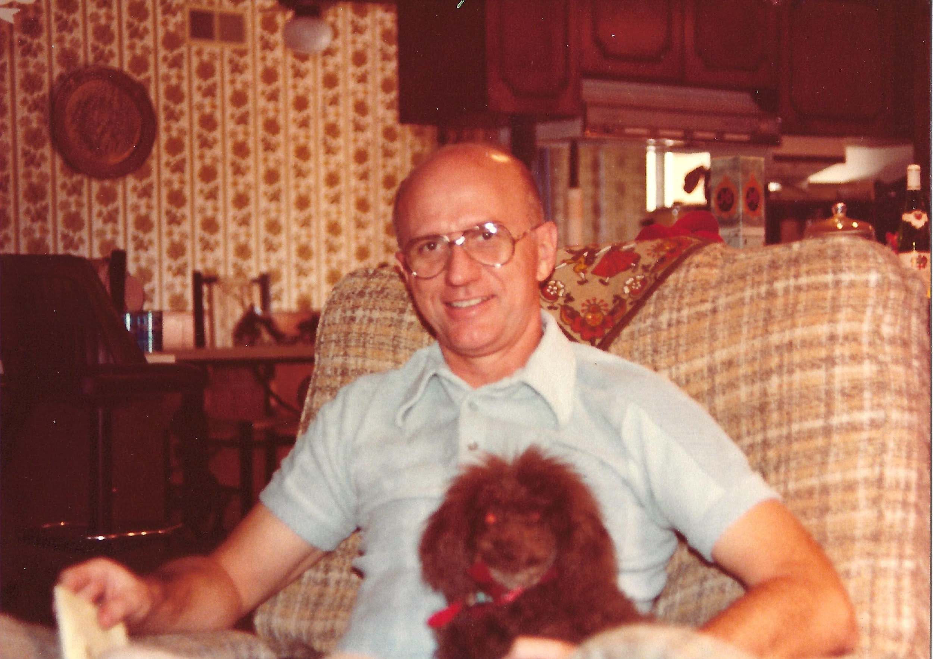
Little Bit in her happiest place

Slide 22
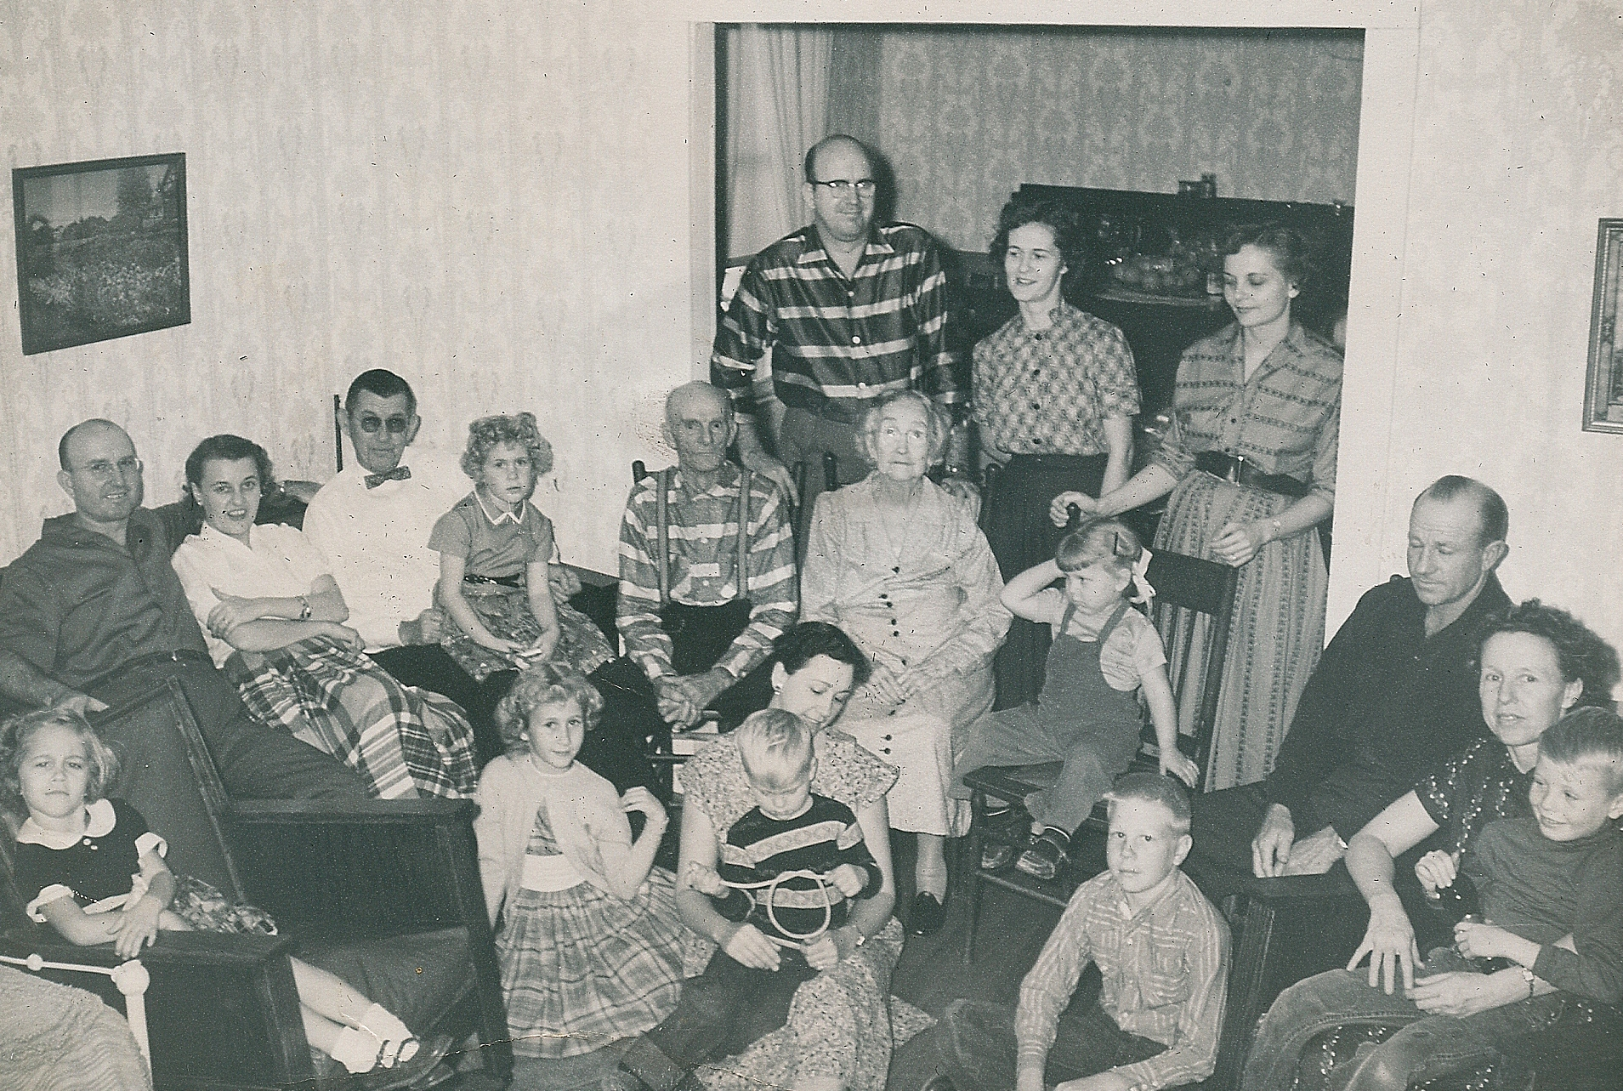
At Grandparents Burger family gathering

Slide 23
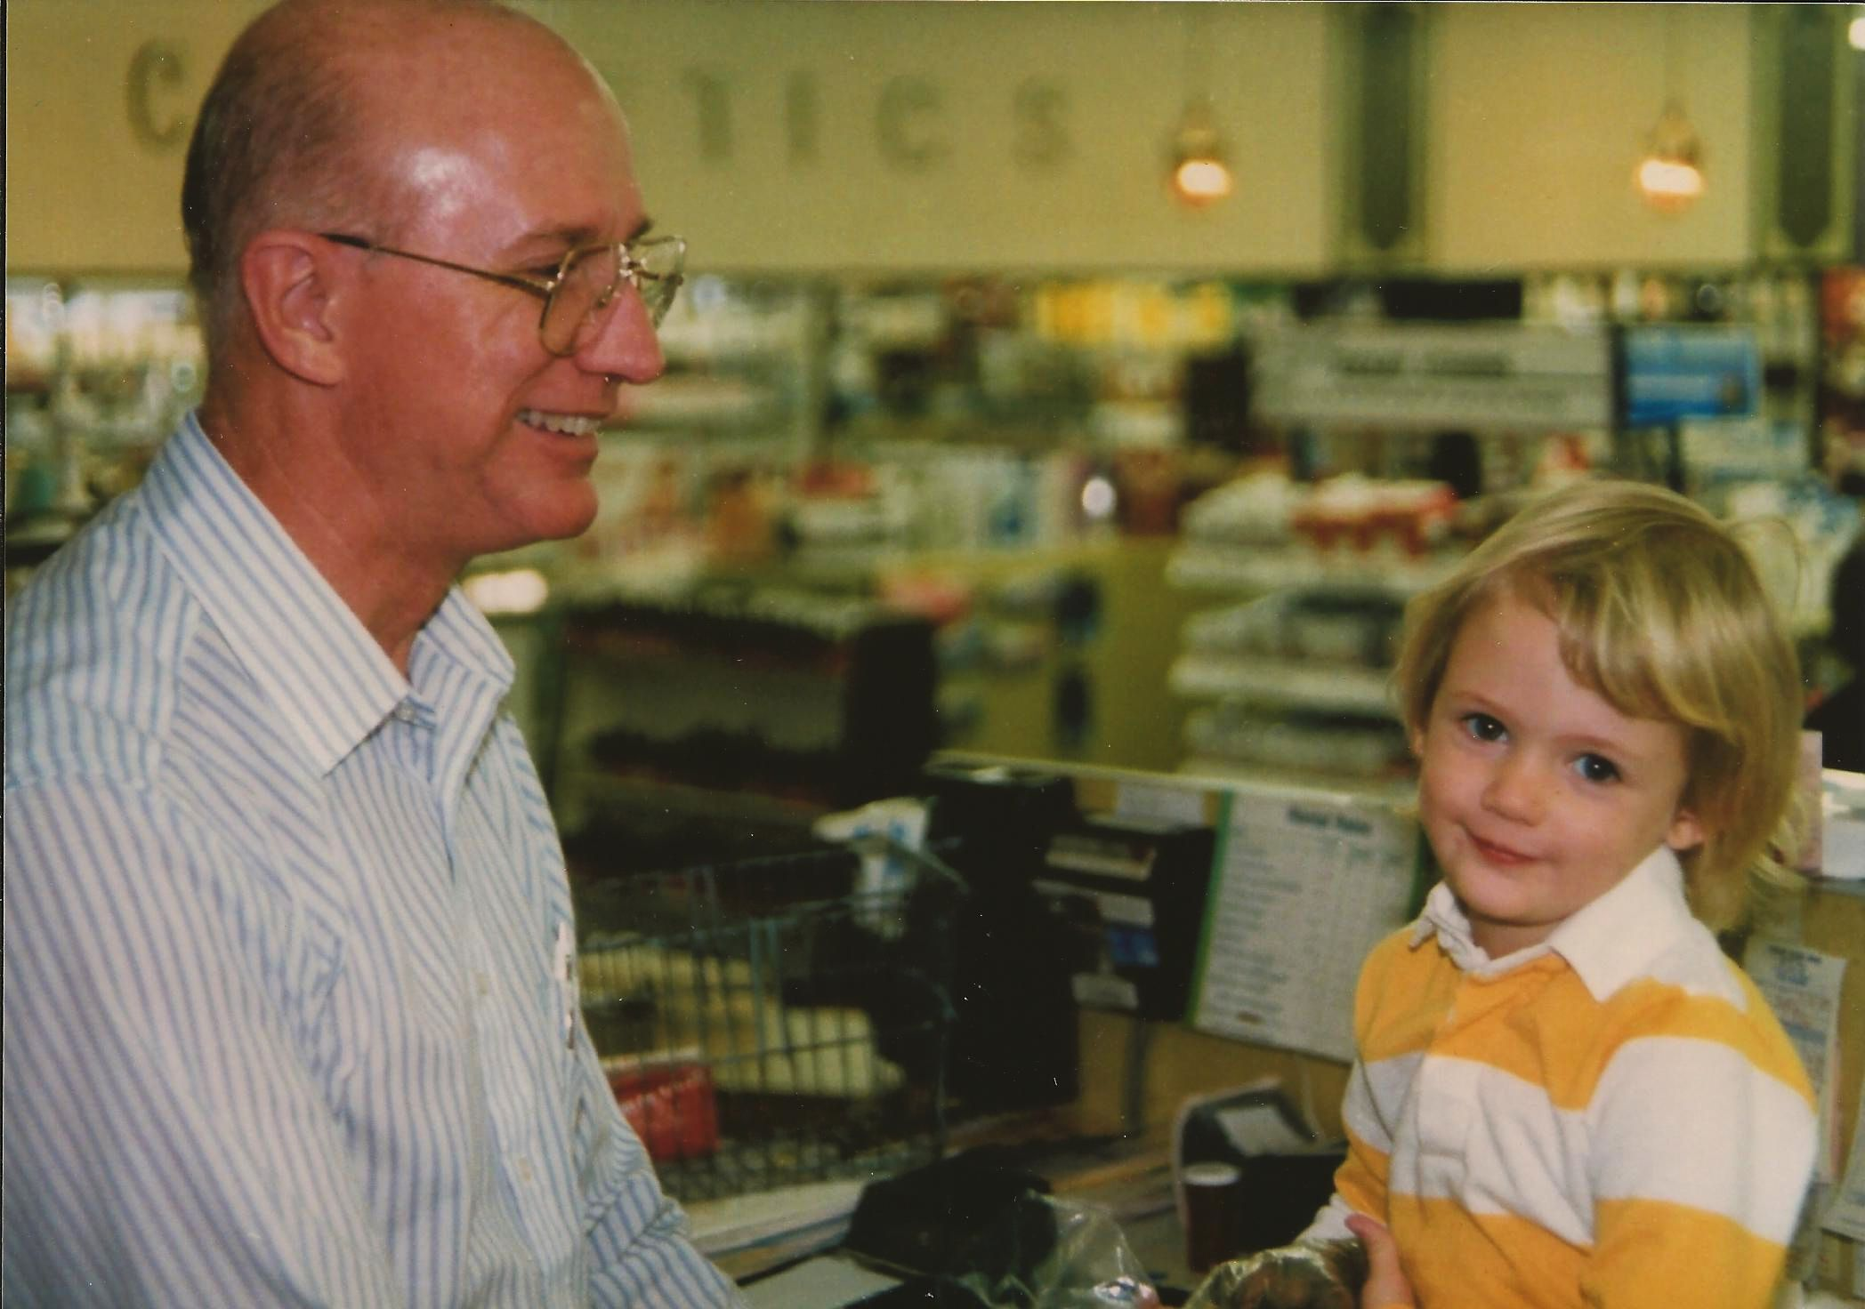
Really Grandad?

Slide 24
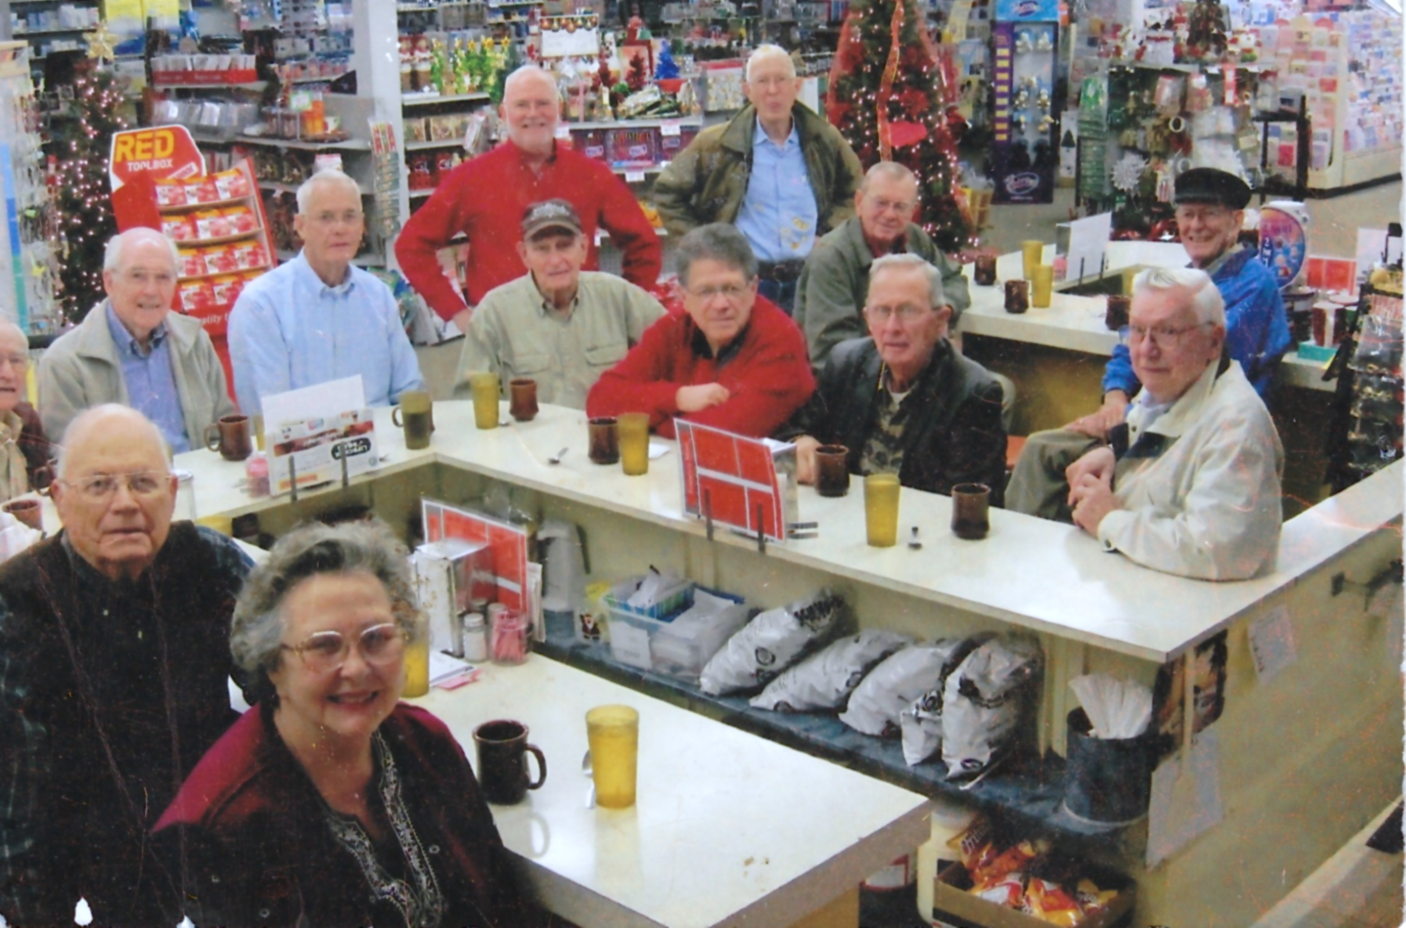
Fun friends in the Coffee Bunch

Slide 25
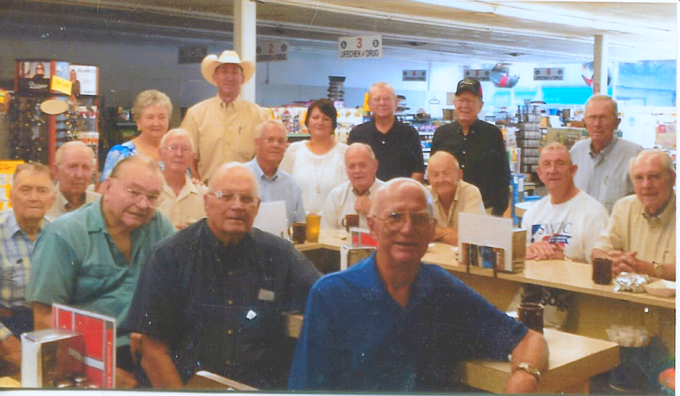
Steve Hoag, George Wentz, Jack Van Cleve, Ben Harp, Hubert Zinzmeister, Ann Molloy, Bruce Kingsbery
Dub Stewart, Sandra, Jack Malloy, Ed Stanfield, Charles Raine, Jerry Brewer, John Harrell, Rodney Reagan

Slide 26
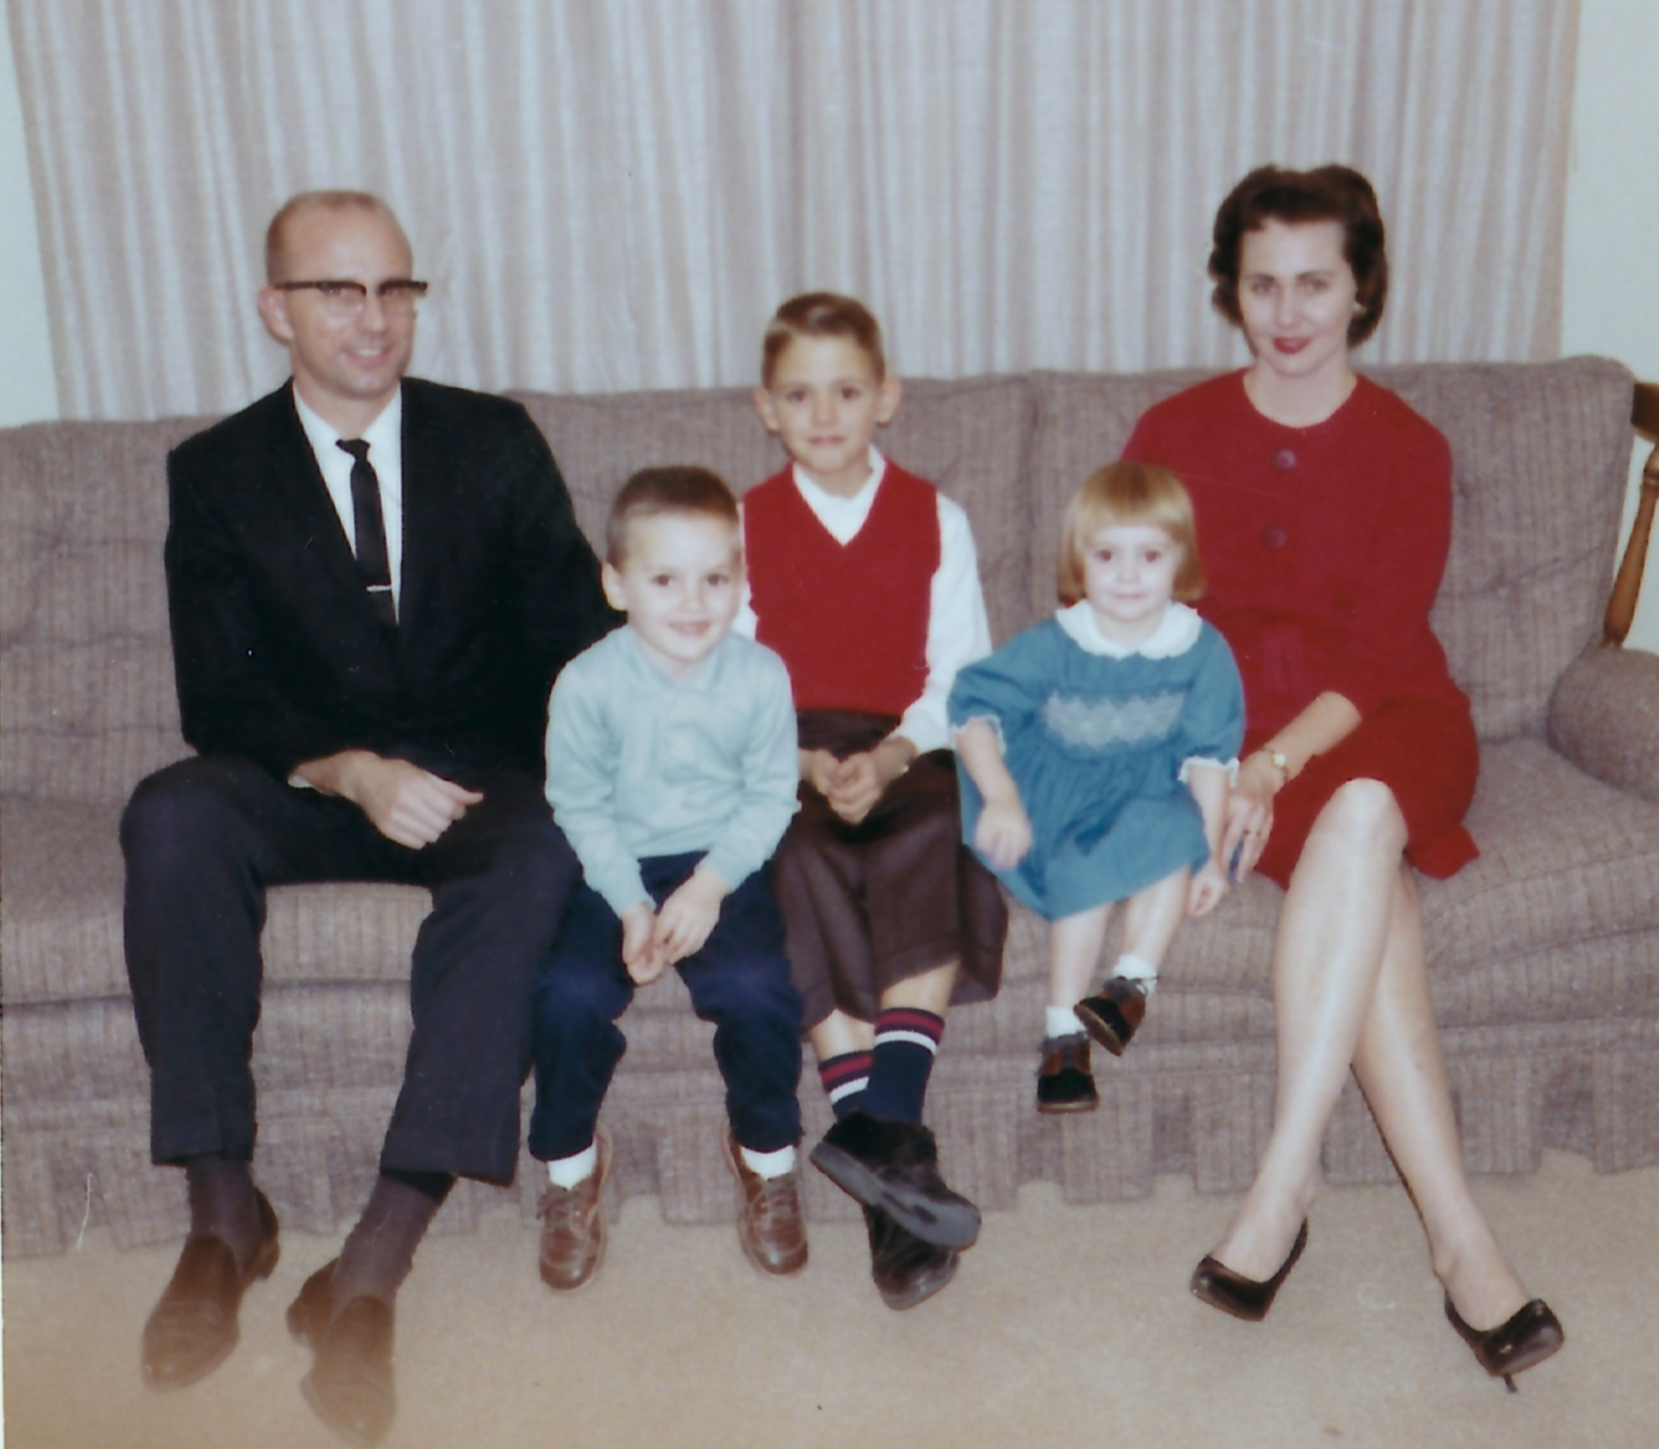
Alan, Wayne, Ron, Anna Bea

Slide 27
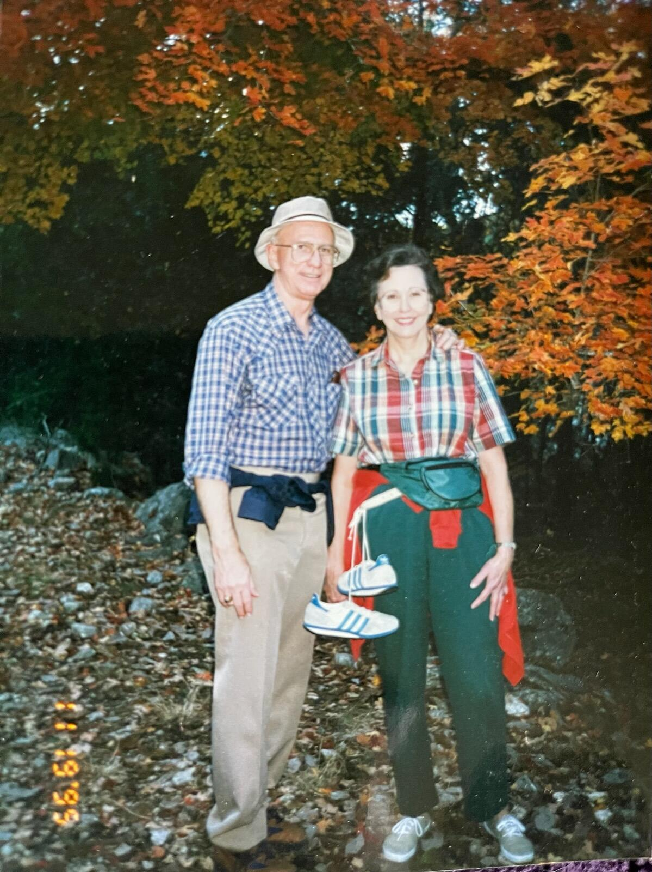
Hiking in Lost Maples

Slide 28
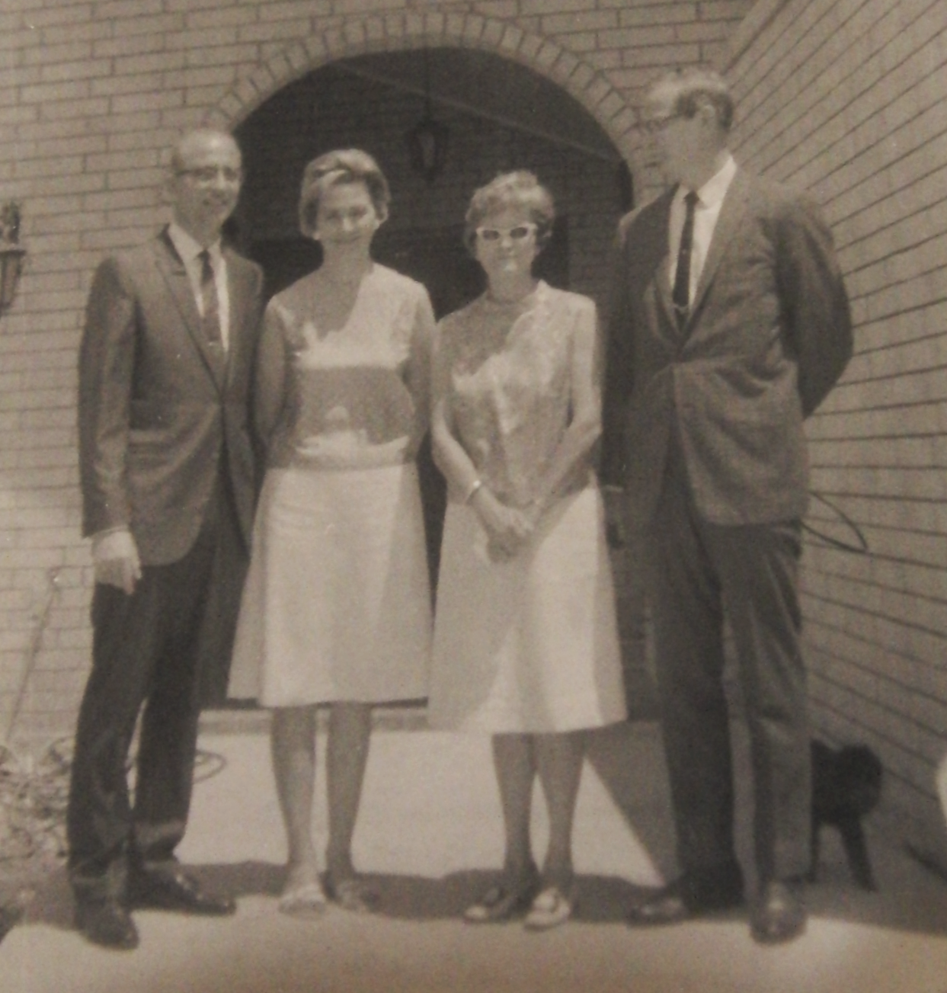
With Art and Mary Anderson

Slide 29
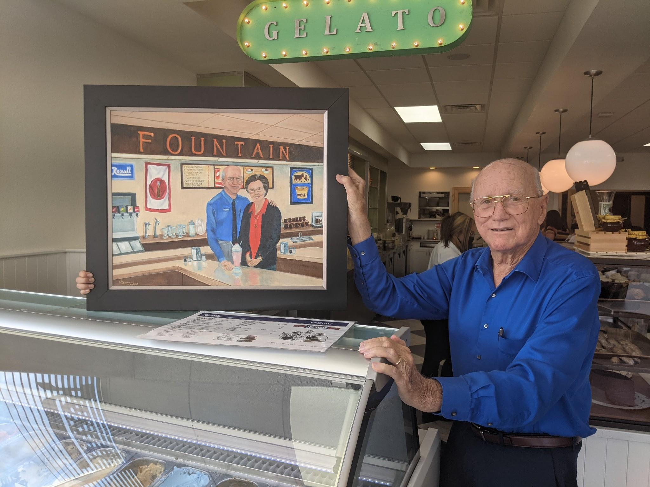
They’ll always be at Rexall’s

Slide 30
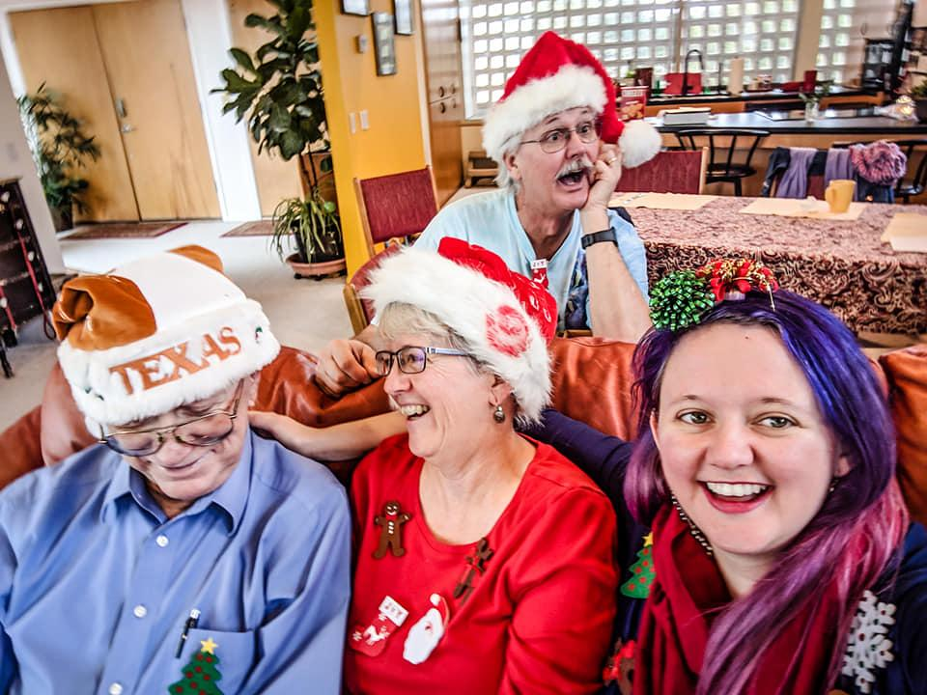
Wacky Christmas moments

Slide 31
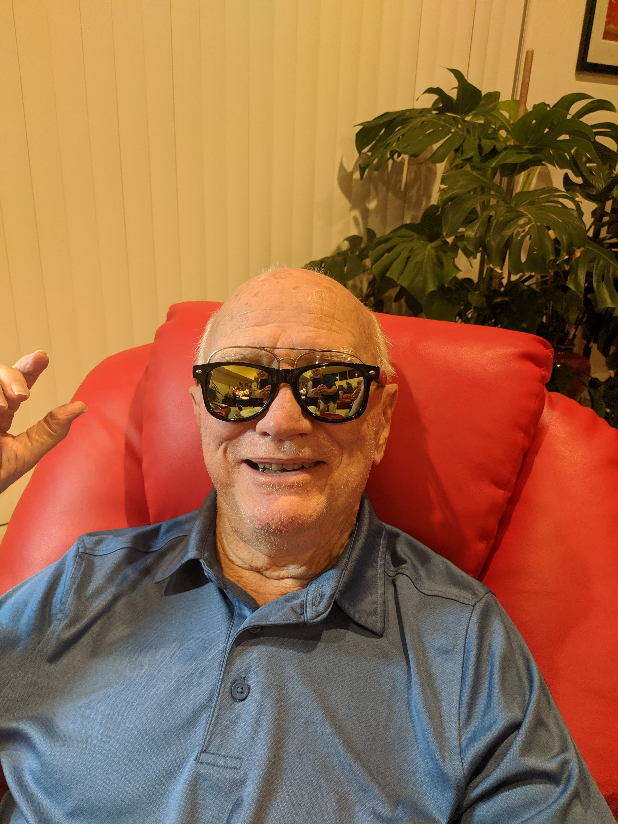
One
Very
Cool
Dude!

Slide 32
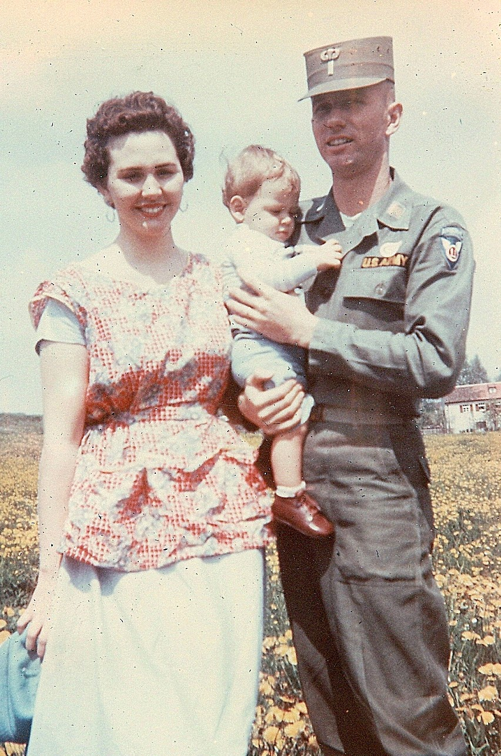
1955 in Augsberg, Germany

Slide 33
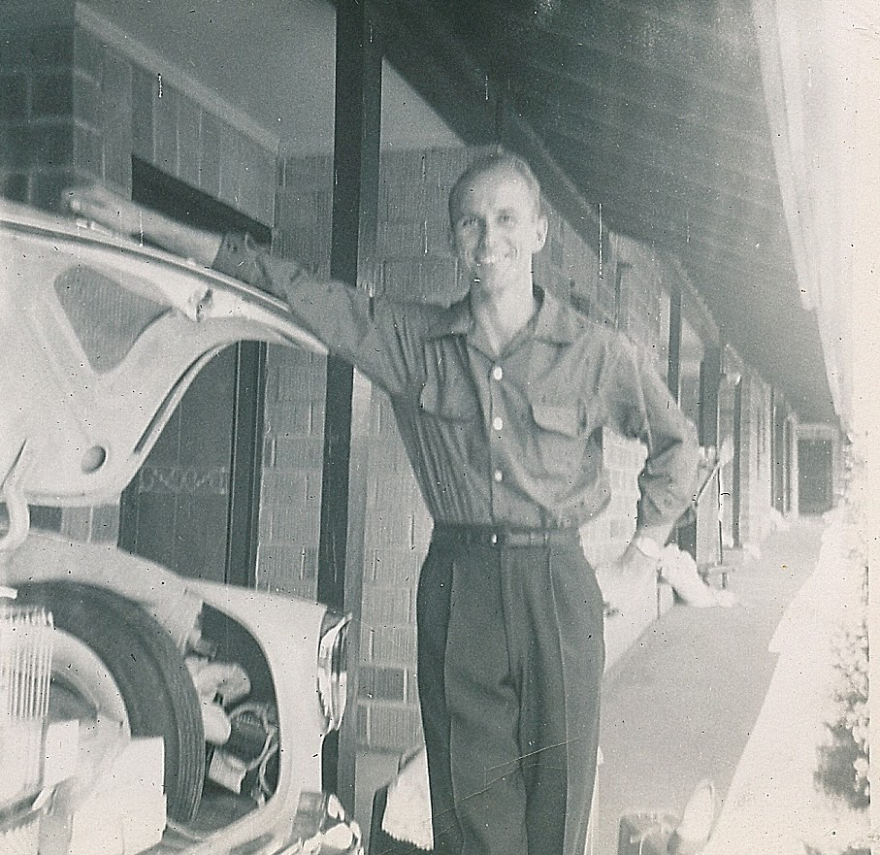
A very dapper Alan
1955

Slide 34
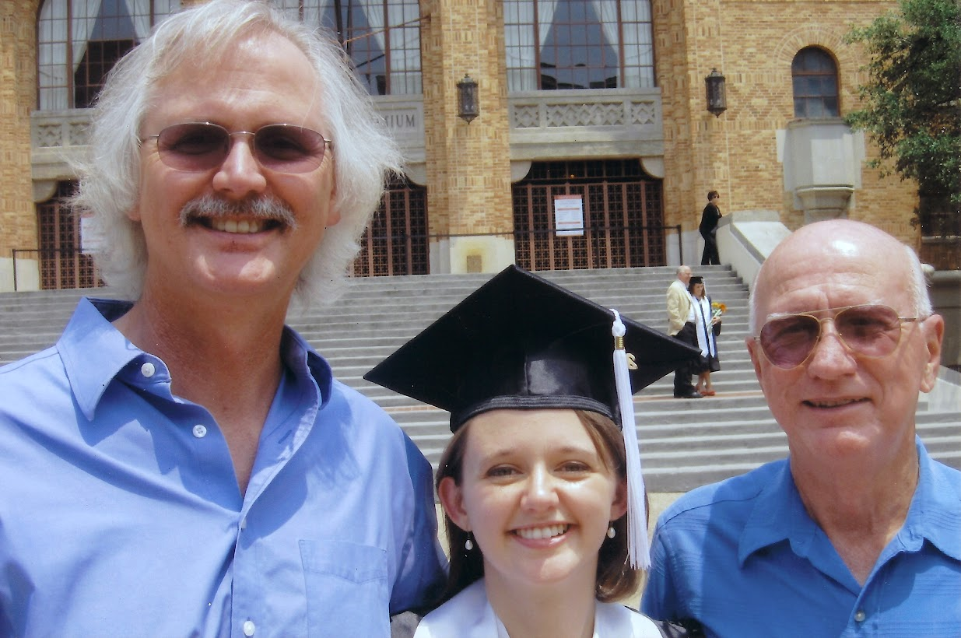
3 Generations of Longhorns

Slide 35
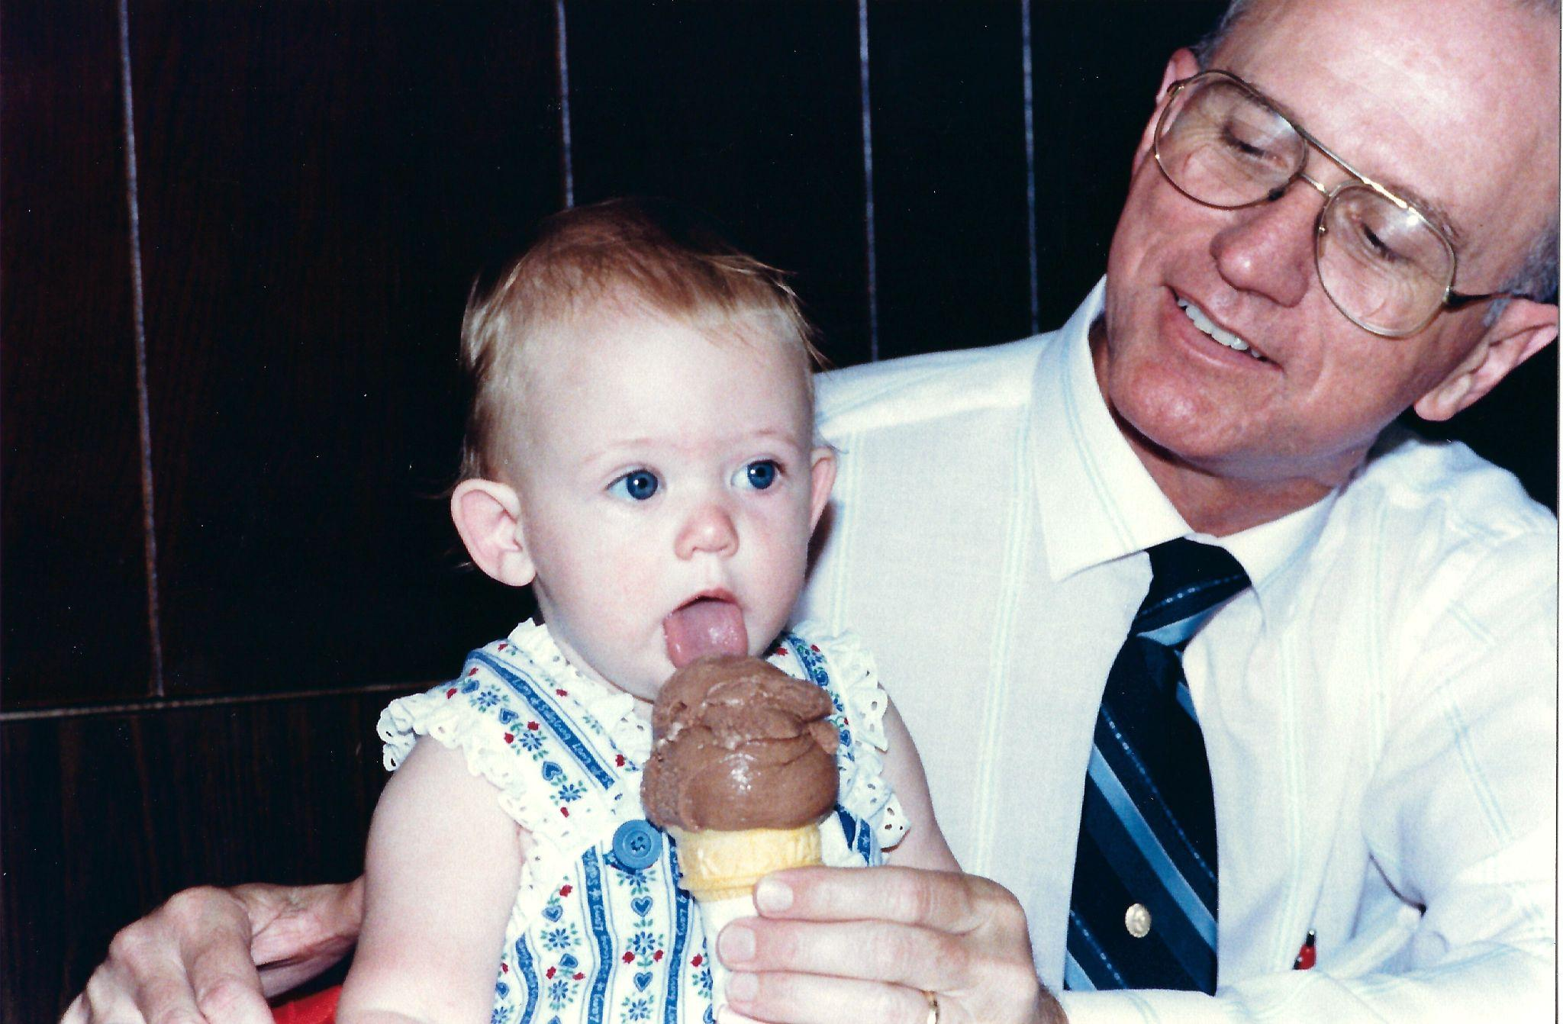
All Texans love Blue Bell!

Slide 36
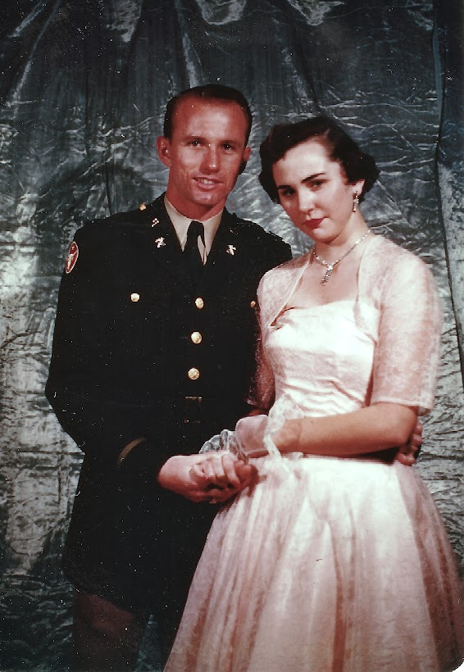
Together at UT 1954

Slide 37
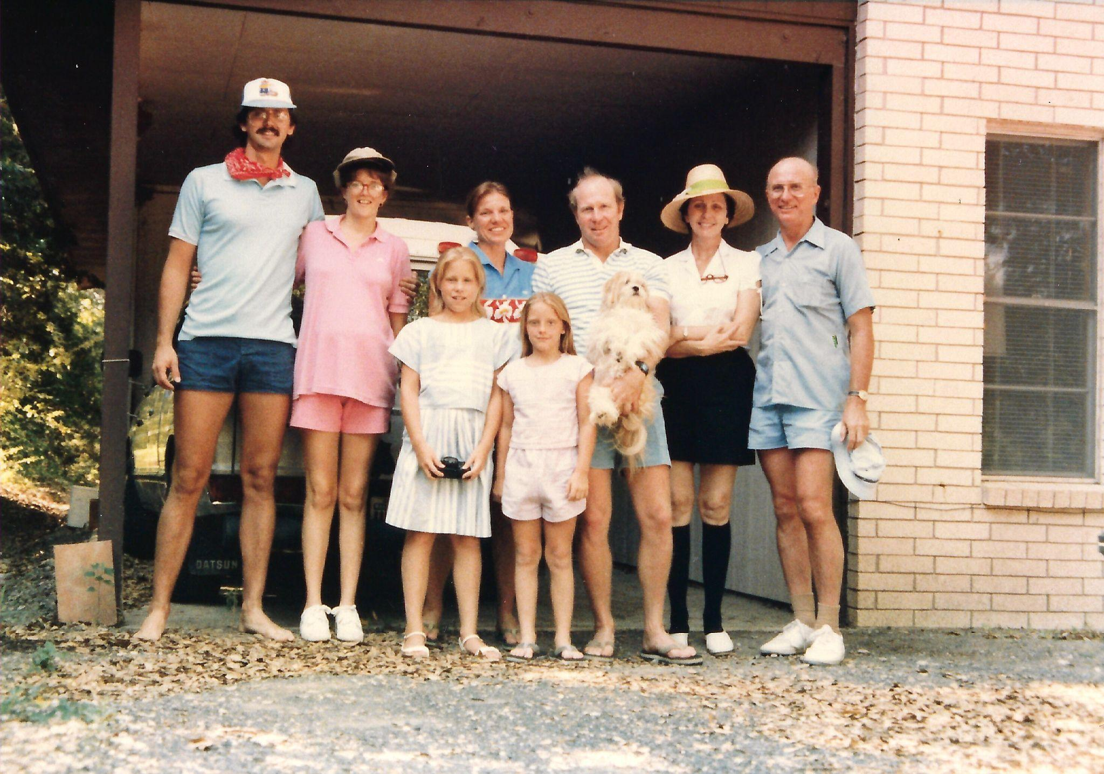
Ready to tube the Frio with the Mosses

Slide 38
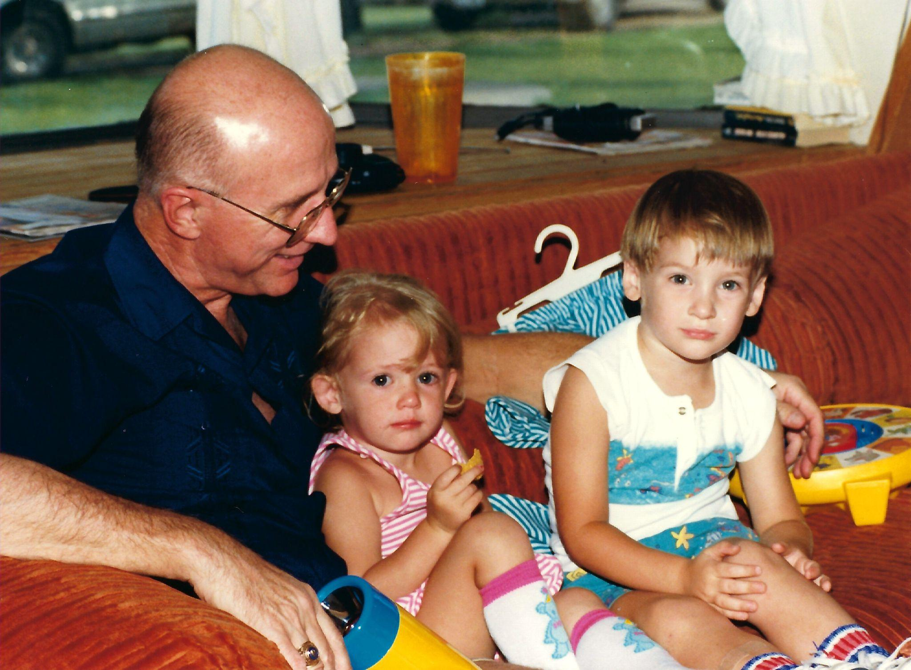
Two tired grandkids… one happy Grandad

Slide 39
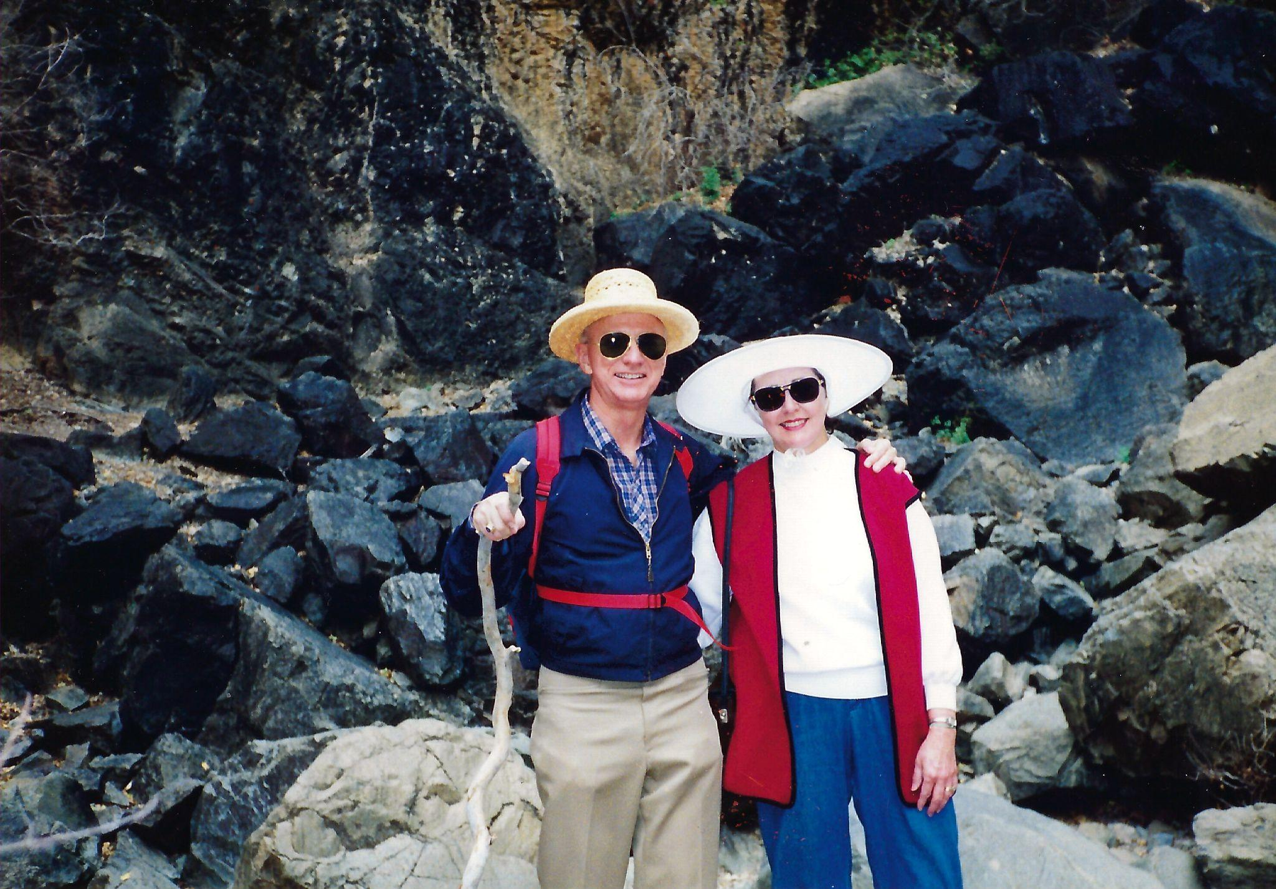
Hiking in Big Bend

Slide 40
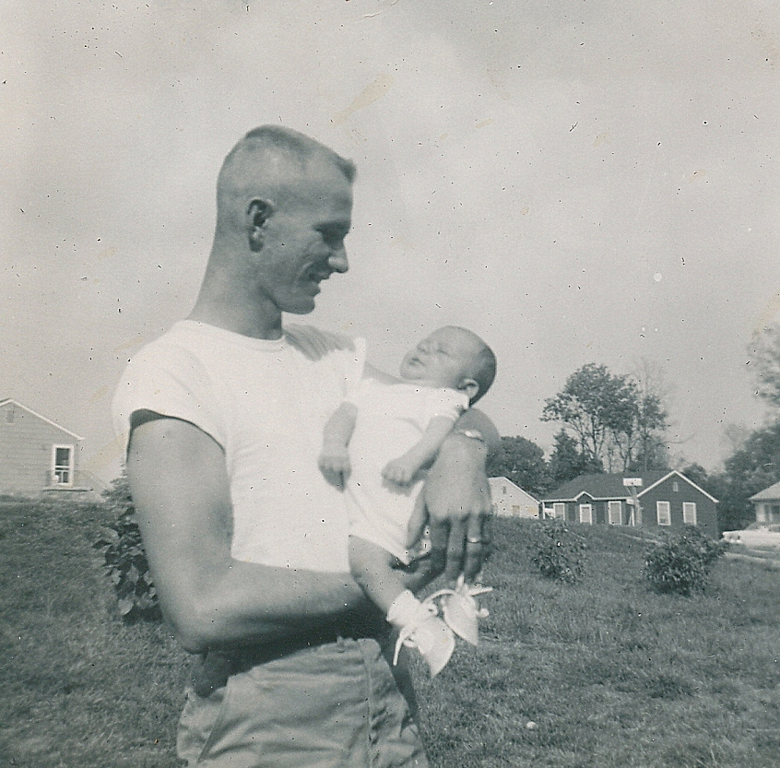
A new father at Ft Campbell, Kentucky

Slide 41
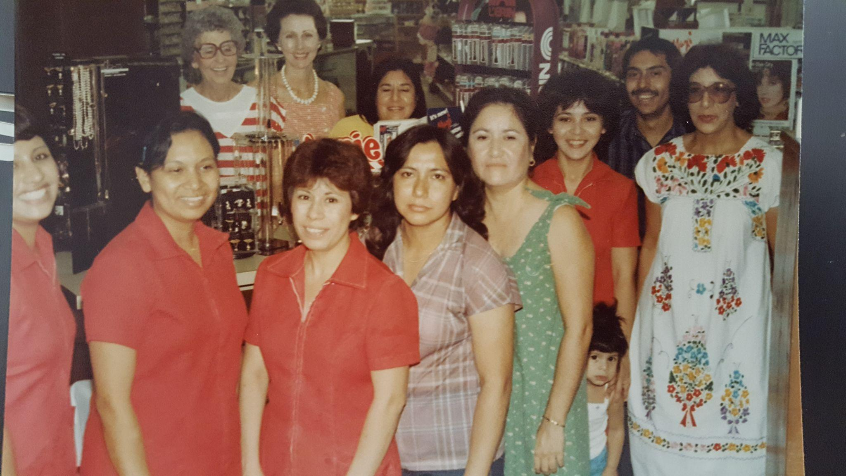
Best employees in the world!

Slide 42
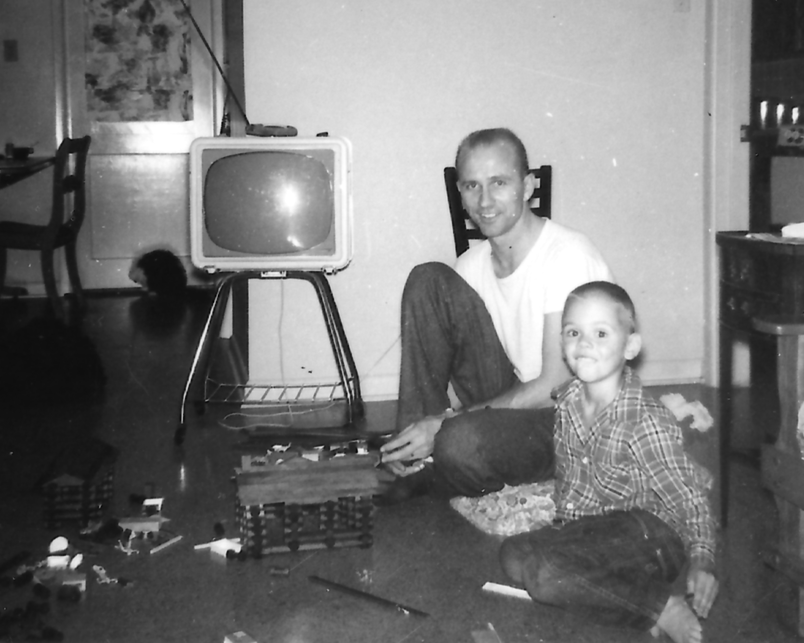
Fun with Lincoln Logs

Slide 43
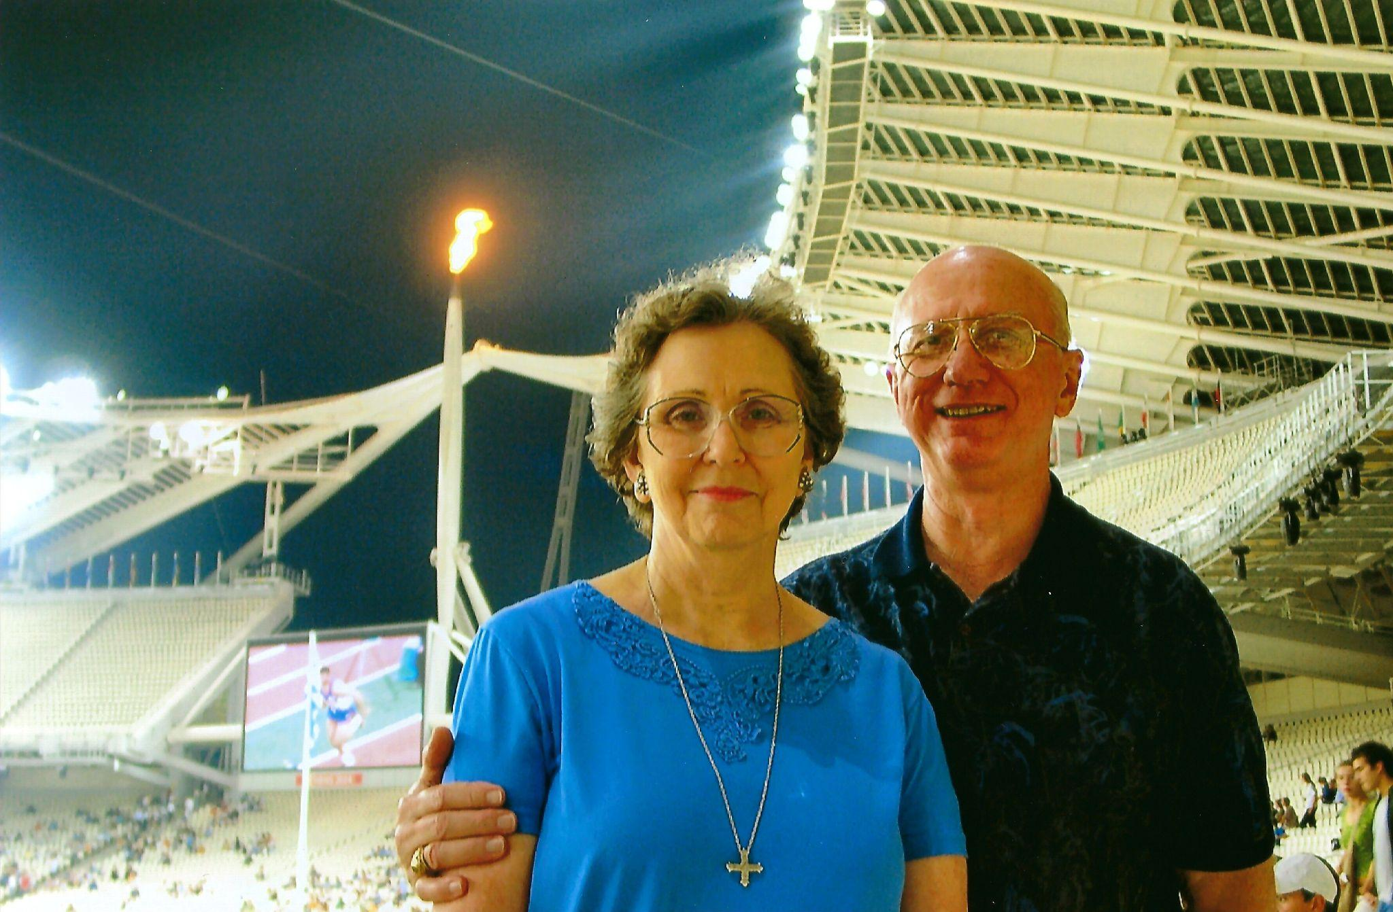
Opening Ceremonies 2004 Paralympics - Athens Greece

Slide 44
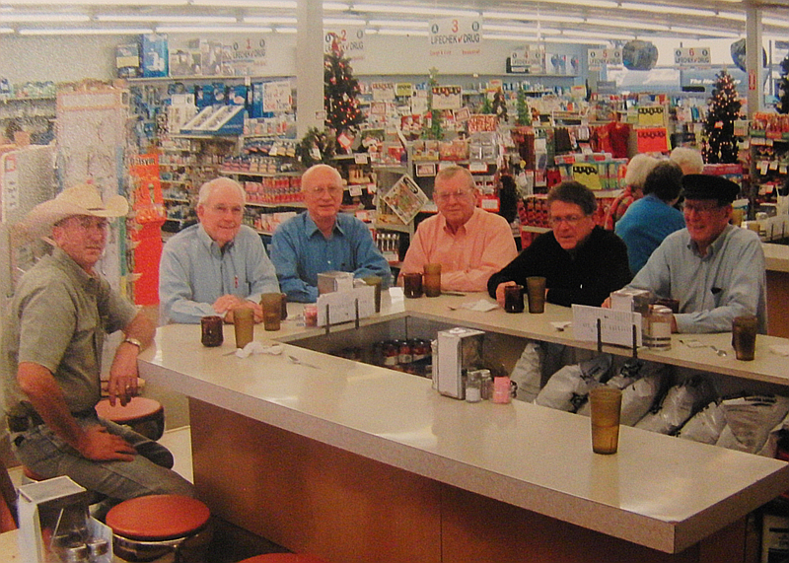
A fountain of friends!

Slide 45
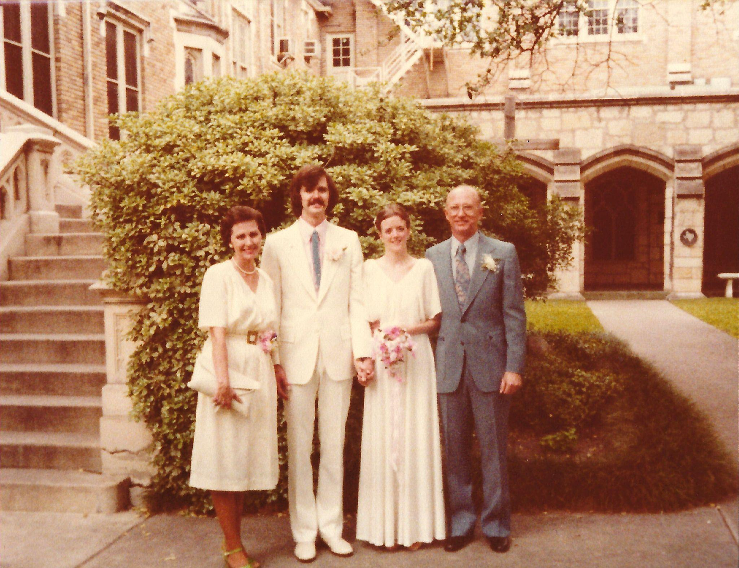
Ron and Gina’s Wedding in San Antonio

Slide 46
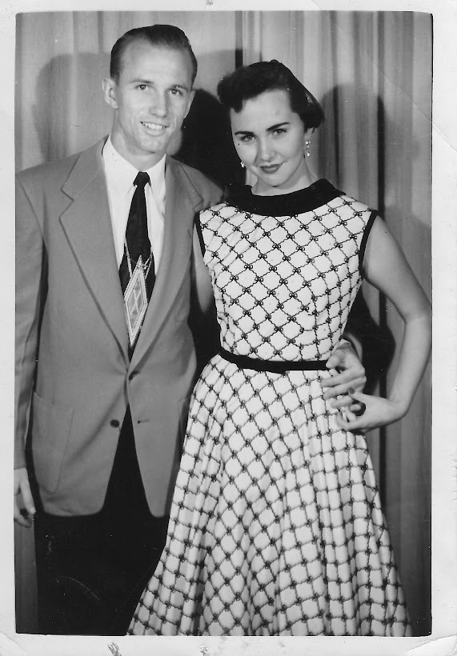
All dolled up for the dance…

Slide 47
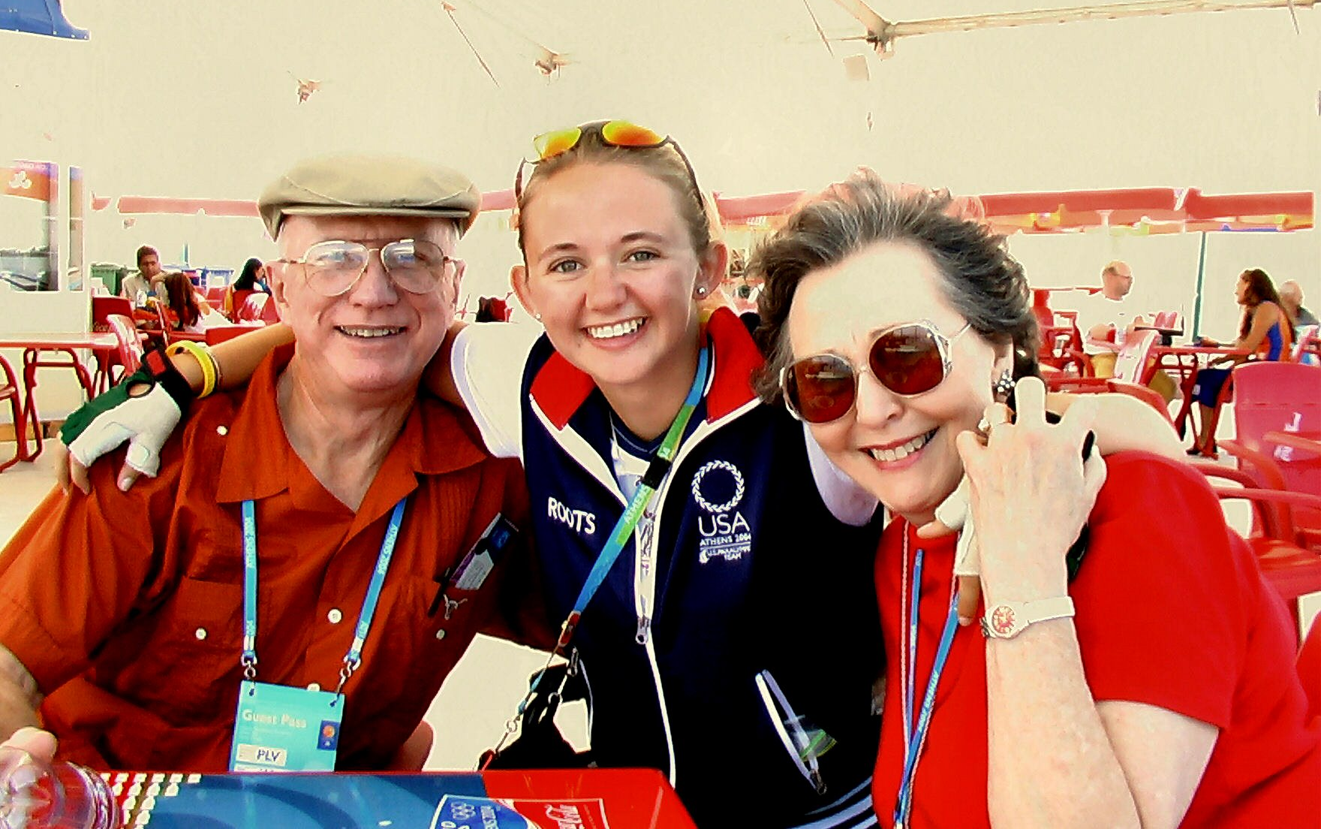
Snuck into Athlete’s Village - Athens 2004

Slide 48
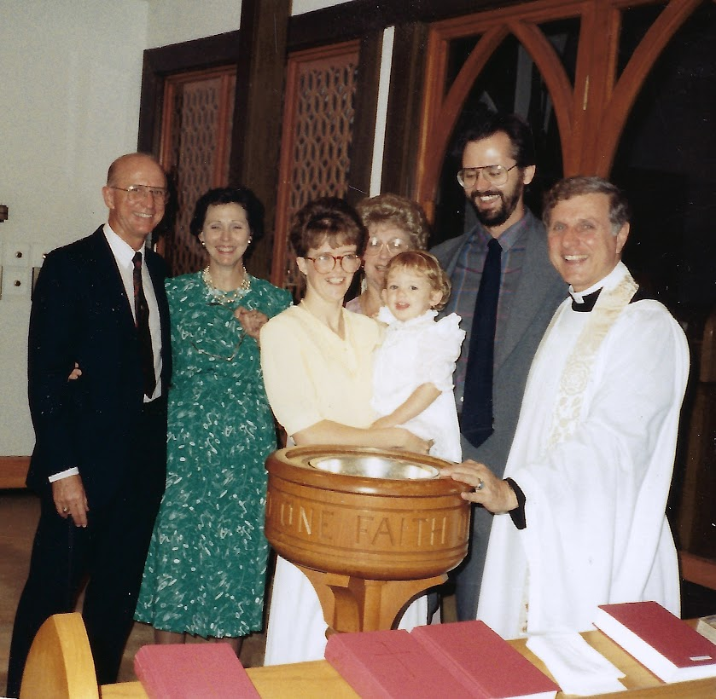
Lindsey’s Christening with Nick Mayer at St Philips

Slide 49
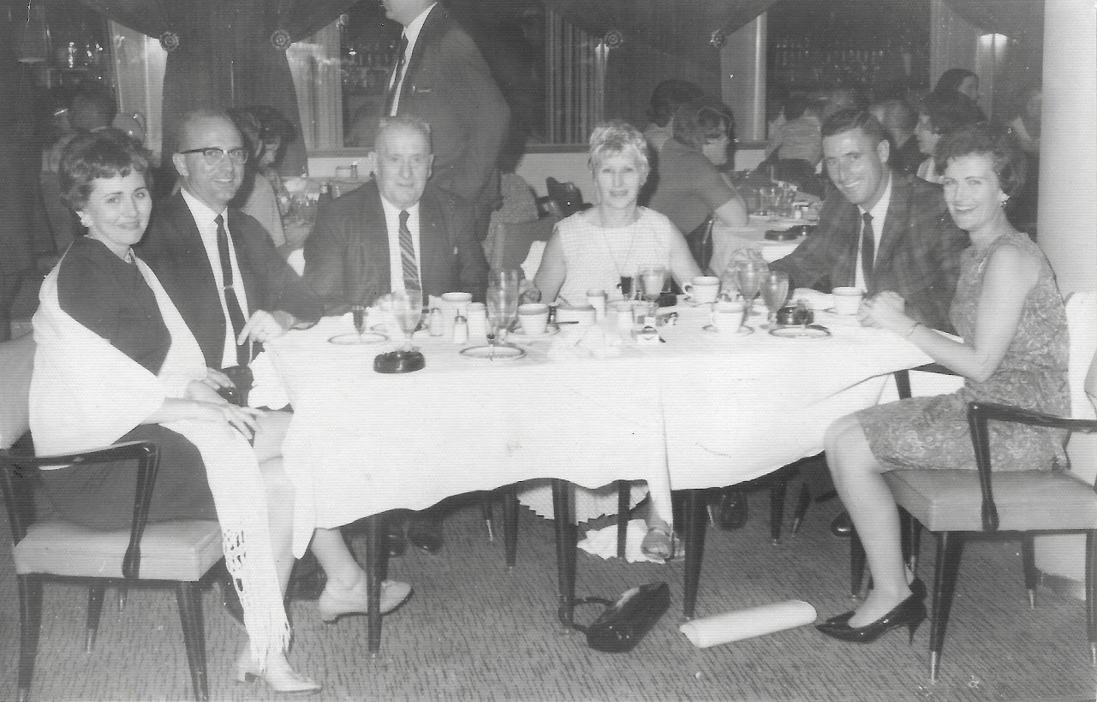
At The Moderno in Mexico with the Pattens (John & Patti and John’s parents)

Slide 50
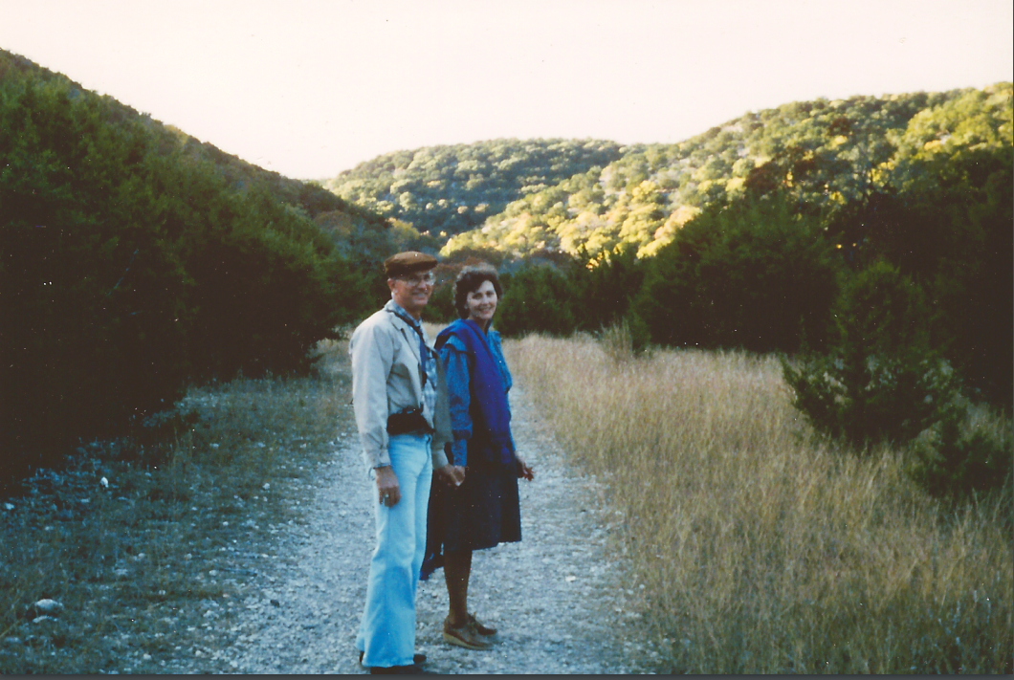
Hand in hand together at Lost Maples

Slide 51
From ROTC to Airborne at UT 1954

Slide 52
At St Philips with Wayne and Rhonda

Slide 53
Fitting in at Denali, Alaska

Slide 54
It’s not work if you’re with people you love..

Slide 55
With Bea’s brother Art and his wife Mary

Slide 56
With aunt Ann Moss and Mother Ada

Slide 57
With Mother and brother Larry

Slide 58
Handsome already at 13

Slide 59
Afternoon at the soda fountain with Bea, Lindsey and Jonathan

Slide 60
Bea & Alan, Carol Jean & Pat Reardon, Eleanor & Bill Ballard, Toni & Jess Ward, Joyce & Bill Thomas, Art & Frances McKinley – Monthly Bridge Group

Slide 61
Wilson Rowe, Robert McNeil, Clarence McNeil, Mr Bob McNeil, & others on the way to canoeing in Big Bend

Slide 62
Mykonos, Greece. Ready for my gyro and beer

Slide 63
Proud Eagle Scout parents

Slide 64
Up in the Highlands of Scotland

Slide 65
Silly fun at college party
“We just beat A&M”

Slide 66
Cool Sunday afternoon at the Frio

Slide 67
Hiking Boquillas Canyon in Big Bend with Dorothy McWhirter

Slide 68
Pet show with Bea, Grandmother Anderson, Wayne, Little Bit, Sueno, and Diablo

Slide 69
Art, MaryLou, Wayne, Mary, Bea, Gina, Sherie, Buddy, Ron & Alan…. oh, and Little Bit

Slide 70
Taking the Beijing medalist out to Jim’s in San Antonio - 2008

Slide 71
Fun Christmas hats

Slide 72
More fun with hats and mustaches

Slide 73
Ten cents for a bottomless cup of coffee

Slide 74
Dwight Babcock, Dub Stewart, June Smith, Charles Raine, Ted Sanderlin standing in the background…

Slide 75
There’s always time for one more cup… Rudy Cannon, Jack Malloy, John Ilse, Steve Hoag

Slide 76
Dwight Babcock, Dub Stewart, John Harrel, Dusty, Steve Hoag, Ed Stanfield, Arnold McCaleb, Ted Sanderlin, Bea

Slide 77
The ladies: Bea, Toni Ward, Raynice Shudde, Estelle Dubose and Alice Hicks

Slide 78
Double dating with friends at UT

Slide 79
Diving in Cozumel 1981

Slide 80
On tour at Tulum

Slide 81
Evening out with Art and Frances McKinley

Slide 82
East Texas azaleas with Art McKinley

Slide 83
Alan’s Burger cousins from Pearland area

Slide 84
A hug for the bride to be…

Slide 85
Happiness is flying in my ultralight!

Slide 86
Lunch crowd at Denali Park

Slide 87
Early days before Rexall’s, fresh out of the Army

Slide 88
Sunny lunch in Athens

Slide 89
Such a great pair…

Slide 90
West coast adventure with Bea & Precious

Slide 91
High School Senior picture
age 16
Katy High School (Class size of 24)

Slide 92
Corpus Christi home with Bea’s parents Settle & Lois Anderson

Slide 93
Doing a walk-about in Scotland

Slide 94
Cooling off in the Frio with Lindsey, Gina & Anna

Slide 95
Going through photos old & new

Slide 96
Playing in the rain…

Slide 97
Handsome Army officer

Slide 98
Sunny day at the Parthenon

Slide 99
Proud owners for nearly 50 years

Slide 100
Down on the field at half-time

Slide 101
#4 El Norte with Wayne, Alan, Larry, Barbara, Bea, Anna & Wilson

Slide 102
At Arches National Park in Utah with Wayne

Slide 103
Proud Chamber of commerce flag bearers with Mary Chapoi

Slide 104
Church Photo

Slide 105
A golfer’s dream vacation spot in Scotland

Slide 106
The Skiing Carmichaels

Slide 107
Spelunking with Bruce & Patti Wilder

Slide 108
Touring the Smoky Mountains

Slide 109
So much laughter shared!

Slide 110
Photo op with
“The Best Dog
in
Texas”
Precious’ hair by Gay Faglie

Slide 111
Logan and Grandad (Carol Moss in background)

Slide 112
Dockside at Lake Travis with Ron, Lindsey & Bea

Slide 113
Two happy skiers

Slide 114
2006 Uvaldean of the Year

Slide 115
Leon, Ross, Sherie, Buddy, Alan, Grandmother Anderson, MaryLou, Anna, Wilson, Wayne

Slide 116
Befriending French cyclists biking across the U.S.

Slide 117
There’s no place I’d rather be…

Slide 118
On the road with Rhonda and Wayne

Slide 119
Dining al fresco with Stephan, Vergie, Art and Frances McKinley

Slide 120
Poolside dining with Dave & Nita Rowe

Slide 121
At Yellowstone with a copy of Uvalde Leader News

Slide 122
Oh so happy, traveling together….

